Slide 1
CERT Organization
USC CERT Basic Training

Slide 2
Setting the Stage
CERTs are able to:
Assist emergency services personnel when requested in accordance with standard operating procedures (SOPs) developed by the sponsoring agency and by area of training
Assume some of the same functions as emergency services personnel following a disaster
Prepare families and communities prior to emergencies and assist neighbors during an emergency when first responders are not immediately available

Slide 3
Course Preview
Unit 1: CERT Organization
Unit 2: Fire Safety and Utility Controls
Unit 3: Disaster Medical Operations, Part 1
Unit 4: Disaster Medical Operations, Part 2
Unit 5: Light Search and Rescue Operations
Unit 6: Disaster Psychology
Unit 7: Disaster Preparedness

Slide 4
Unit 2 Objectives
Describe the CERT organizational structure
Explain the Incident Command System (ICS) and how CERT operates within this structure
Describe the 9-step one-scene size-up process
Describe how to use CERT standard documents

Slide 5
Principles of On-Scene Management
Maintain the safety of CERT workers
Provide clear leadership and organizational structure
Improve effectiveness of rescue efforts

Slide 6
CERT On-Scene Management
Well-defined management structure
Manageable span of control
Common terminology
Effective communication
Consolidated action plans
Comprehensive resource management
Accountability

Slide 7
Objectives for On-Scene Management
Identify scope of incident
Determine overall strategy
Deploy resources
Document actions and results
Notes:
Identify scope of incident – are you going to be performing fire suppression, search & rescue, medical operations, cribbing, etc.?
Determine overall strategy
Deploy resources
Document actions and results

Slide 8
Incident Command System
Non-CERT roles
Public Information Officer
Liaison Officer
Safety Officer
Environmental Health & Safety

Slide 9
CERT Operations
Command structure
CERT Team Leader (TL)
Command Post (with DPS)
Expanded structure as needed

Slide 10
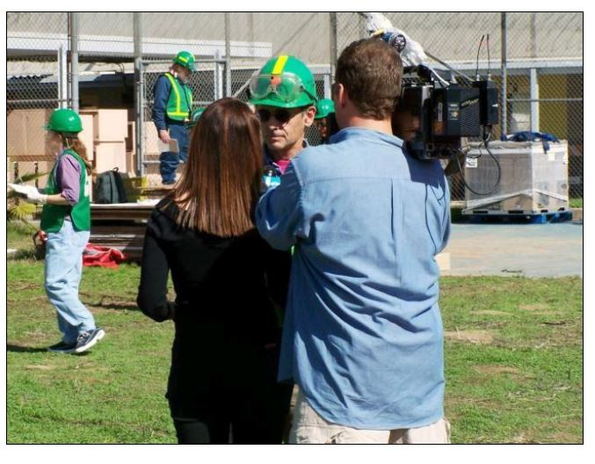
Dealing with the Media
Refer media inquiries to DPS Incident Commander
Do not let media inhibit CERT goals
Be careful about information released

Slide 11
NIMS Implementation
Ability to work together
IS-100: Introduction to ICS
https://emilms.fema.gov/IS100c/curriculum/1.html
IS-700: Introduction to NIMS
https://emilms.fema.gov/IS700b/curriculum/1.html

Slide 12
CERT Mobilization
CERTs take care of themselves, their families, their homes, their neighbors
CERT will receive a TrojansAlert Callout
Report to predesignated staging area:
UPC: Pardee Plaza (Trousdale & Exposition)
HSC: CHP Parking Lot
TL is established, organizes the group
TL prioritizes actions (with DPS)
Organization is flexible and evolves based on new information
Notes:
CERTs take care of themselves, their families, their homes, their neighbors (if at home when disaster occurs)
CERT will receive a TrojansAlert Callout (report at first light if in the middle of the night).

Slide 13
On-Scene Size-up
Gather Facts
Assess and Communicate Damage
Consider Probabilities
Assess Your Own Situation
Establish Priorities
Make Decisions
Develop Plan of Action
Take Action
Evaluate Progress

Slide 14
Documentation
Command Post
Documents situation status
Sign in/out
Incident locations
Access routes
Identified hazards
Support locations
Section Chiefs
Provide Command Post with information

Slide 15
Assignments 5)

Slide 16
Assignments 5)

Slide 17
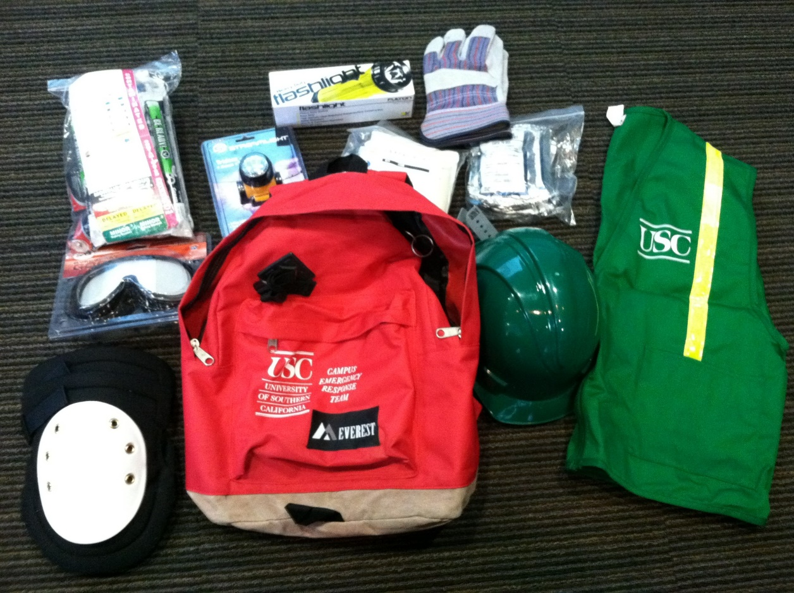
Personal Protective Equipment
Helmet/Head lamp
Goggles
N95 Mask
Gloves (work and non-latex)
Flashlight
Knee pads
First Aid Supplies
Triage tags
Sturdy shoes or work boots

Slide 18
Know Your Role
Be confident in your role
If you are not comfortable with your role talk to the Team Leader and get reassigned!
Safety first

