Slide 1

Fire Safety and Utility Controls
USC CERT Basic Training

Slide 2
Unit 6 Objectives
Explain the role CERTs play in fire safety and response, including the CERT size-up process and minimum safety precautions
Extinguish a small fire using a fire extinguisher
Identify and reduce potential fire, utility, and hazardous materials hazards at work and home

Slide 3
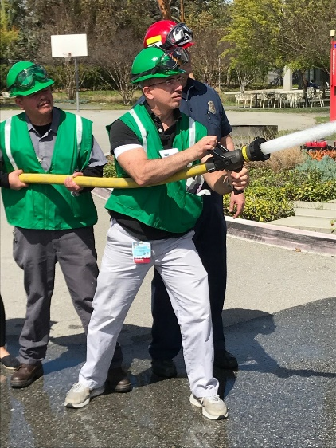
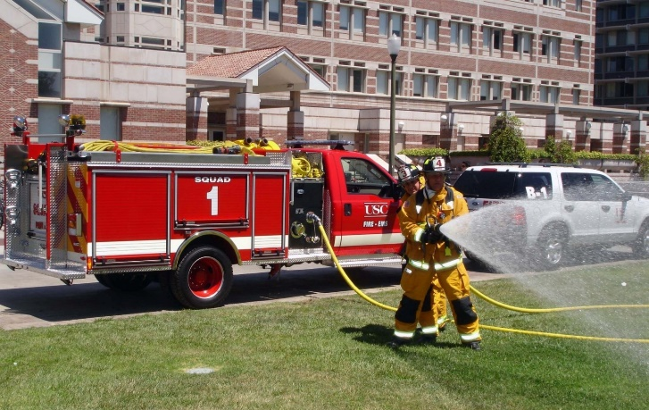
Role of CERTs
USC CERT plays a very important role in fire safety by:
  Extinguishing small fires
  Assist in utilizing the mini pumper
  Preventing additional fires by removing fuel sources
  Shutting off utilities
  Assisting with evacuations, when necessary

Slide 4
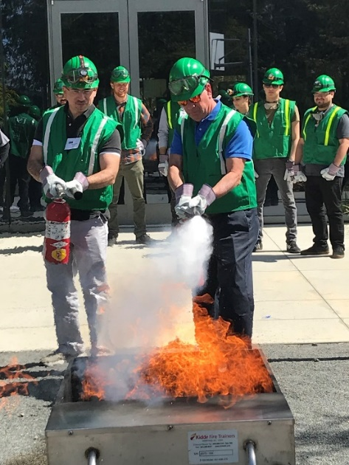
CERT Priorities
Rescuer safety is number one priority
  Always work with a buddy
  Always wear safety equipment
  CERT Goal:
  Do the greatest good for the greatest number

Slide 5
Fire Facts
More Americans killed each year from fire than all natural disasters combined
Many victims are children under five and adults over 65
Fires happen every day in LA
Multiple fires occur after earthquakes; can become firestorms if not quickly controlled
Over $7 billion in property damage annually
Notes:
Fires kill more Americans each year than all natural disasters combined; many victims are children under five and adults over 65
Fires are a much smaller incident than an earthquake, but they happen every day in LA; If a fire happens in your home, it can be a deadly hazard
Multiple fires occur after earthquakes, which can turn into a firestorm if not quickly controlled
Over $7 billion in property damage occurs every year

Slide 6
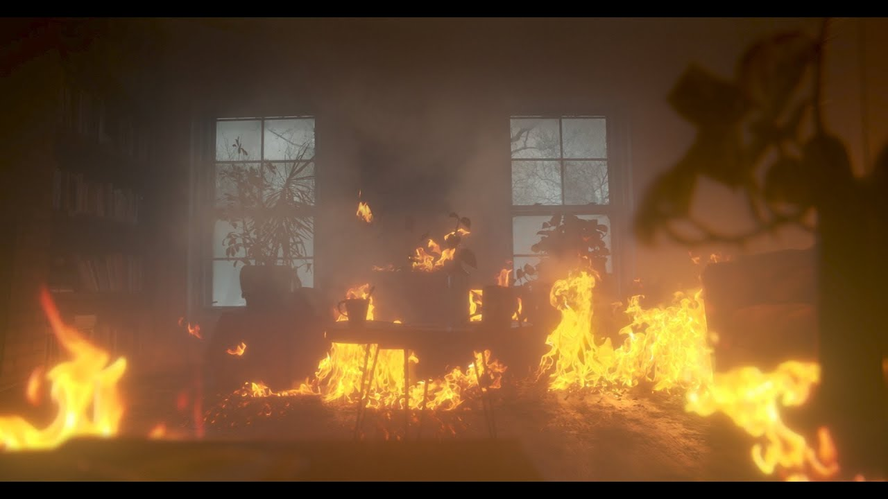
Fire Facts
Fire is FAST! Fires can double in size every 30 seconds
Fire is HOT! Heat is more threatening than flames
Fire is DARK! Fire starts bright, but quickly produces black smoke and complete darkness
Fire is DEADLY! Smoke and toxic gases kill more people than flames do

Slide 7
Fire Facts – USC
Several major fires at Fraternities, some with injuries
Occasional fires in laboratories
Birnkrant Residence Hall (1995) and Troy Residence Hall (1997)
Never a fatality in USC-owned building

Slide 8
The Fire Triangle
If you can knock out one of the Fire Triangle Legs you can knock a fire out!
Heat
Fuel
Oxygen
Chemical Reaction

Slide 9





Classes of Fire
Class A: Ordinary combustibles
Class B: Flammable and combustible liquids
Class C: Energized electrical equipment
Class D: Combustible metals
Class K: Cooking oils

Slide 10
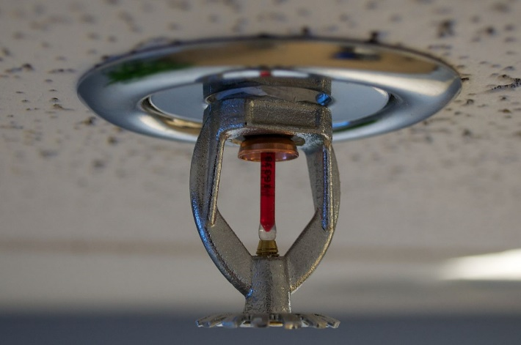

Firefighting Resources
Local fire department
Portable fire extinguishers
Fire alarm system
Sprinkler systems
Smoke Detectors
Interior wet standpipes

Slide 11
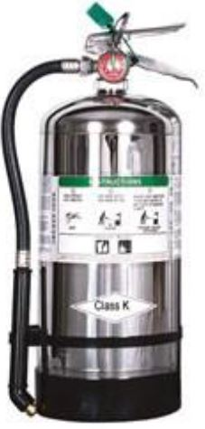
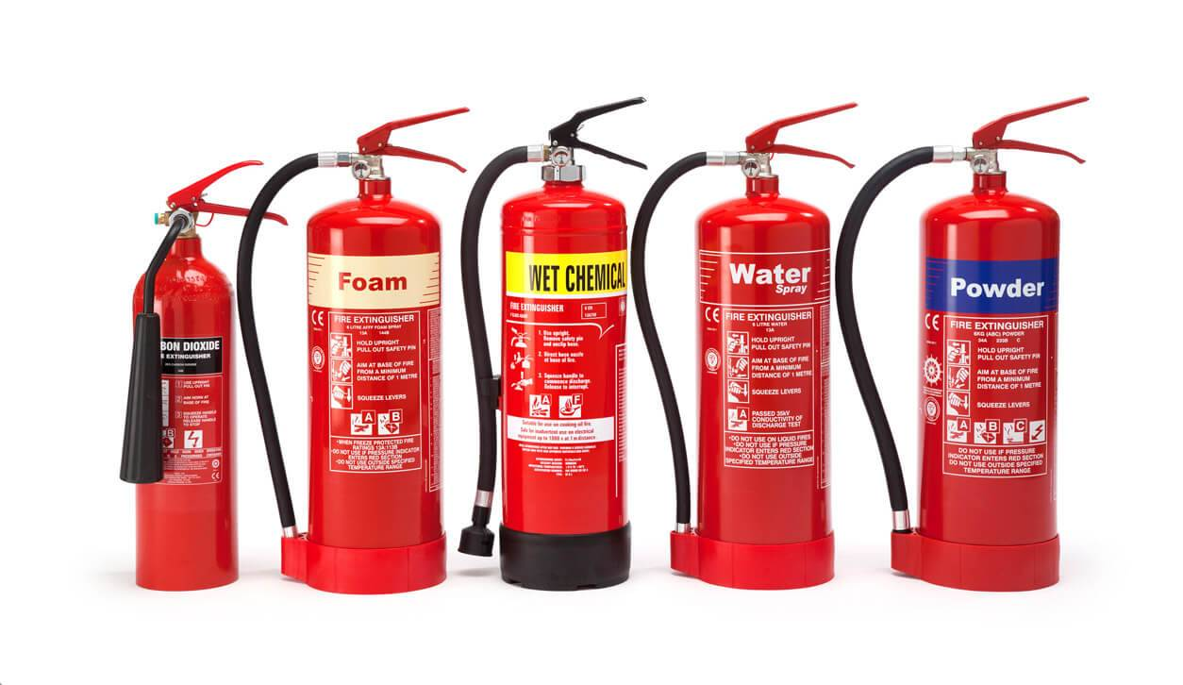
Fire Extinguishers
Water
Dry chemical
Carbon dioxide
Specialized

Slide 12
Fire Extinguishers
Labels show types of fires for which that extinguisher is used
  Class A fire ratings: 1A to 40A
  Class B fire ratings: 1B to 640B
Higher number on label = greater amount of extinguishing agent

Slide 13
CERT Fire Size-up
Helps CERT volunteers decide:
  Whether to attempt to suppress a fire
  A plan of action
Answers these questions:
  Do my buddy and I have the right equipment?
  Are there other hazards?
  Is the building structurally damaged?
  Can my buddy and I escape?
  Can my buddy and I fight the fire safely?
  Remember: The safety of individual CERT volunteers is always the top priority

Slide 14
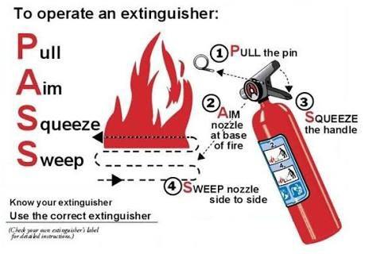
P.A.S.S.
Test the extinguisher after pulling the pin
Pull
Aim
Squeeze
Sweep

Slide 15
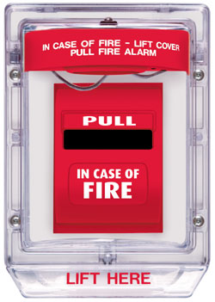
Fire Alarm System
Activated at the pull station
Will sound throughout the building
Alarm alerts DPS and the Fire Department is summoned
Any intentional activation by a resident will result in expulsion from USC housing

Slide 16
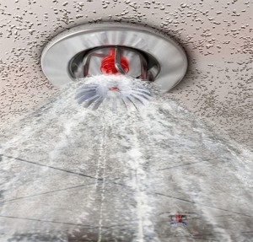
Fire Sprinkler System
Most residential buildings are equipped
Heads activated by heat (165º +) from a fire
Automatic sprinkler system is the very best fire protection available
Sprinkler heads easily broken
  Ex. tossed ball, someone hanging something from the head
Cost of damage is responsibility of the person who damaged the sprinkler (or parents)

Slide 17
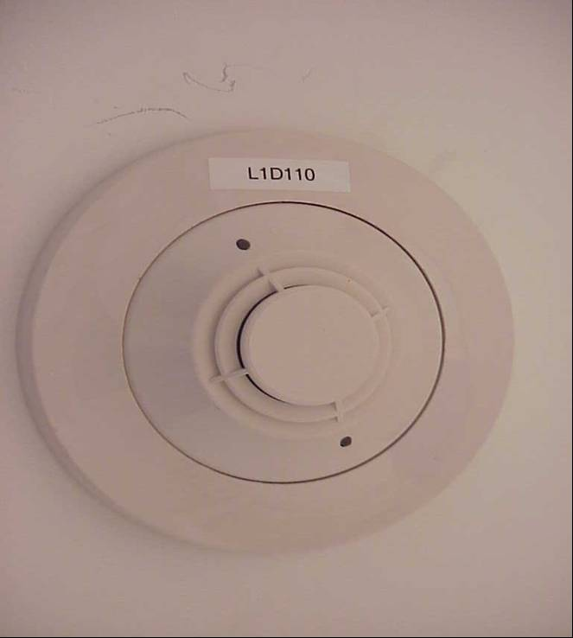
Smoke Detectors
Smoke detectors sound only in your room
Smoke detector is your personal fire alarm that will wake you up
Never cover your smoke detector with a poster or wall hanging

Slide 18
Interior Wet Standpipes
Usually found in stairwells of buildings
CERT members should not operate a standpipe unless trained to do so

Slide 19
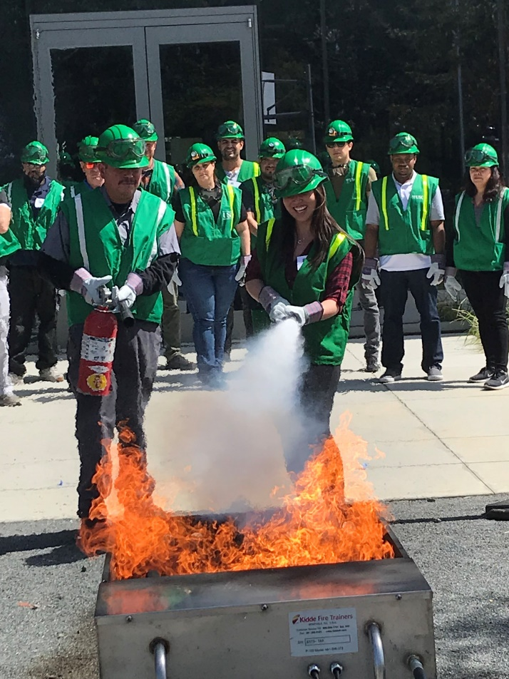
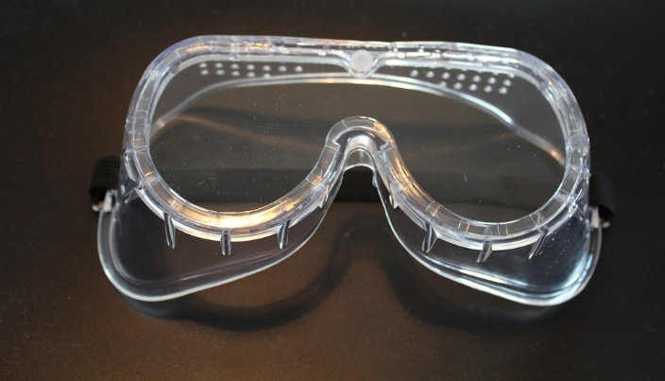
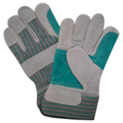
Fire Suppression Safety
Safety of individual CERT members is top priority
Do:
Use safety equipment
Work in a buddy system
Have a backup team
Have two ways to exit
Maintain a safe distance
Overhaul the fire

Slide 20
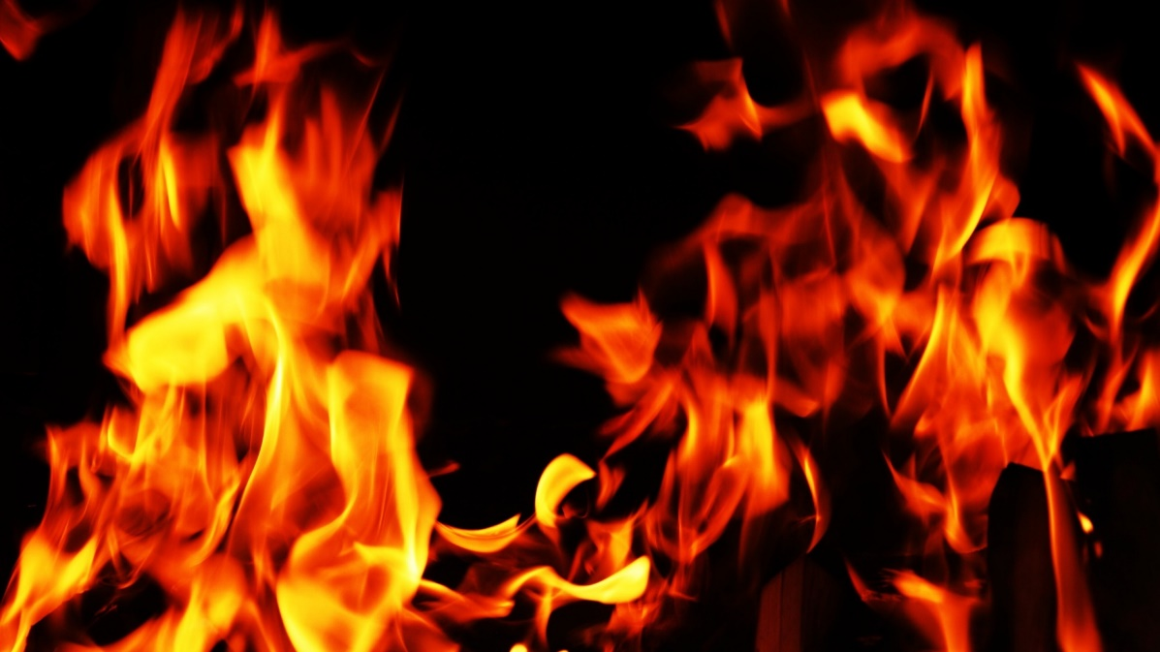
Fire Suppression Dont’s
Don’t get too close
Don’t try to fight a fire alone
Don’t try to suppress large fires
Don’t enter smoke-filled areas

Slide 21
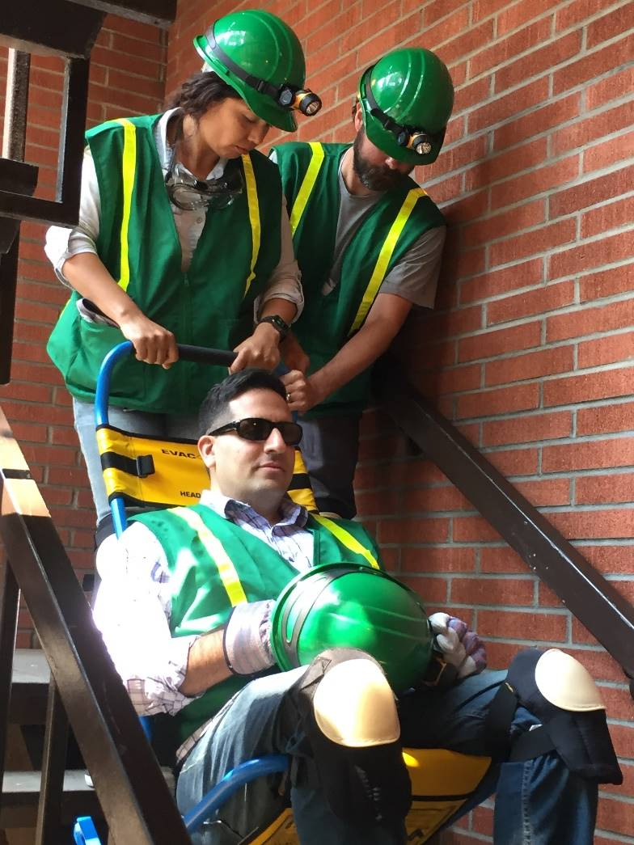
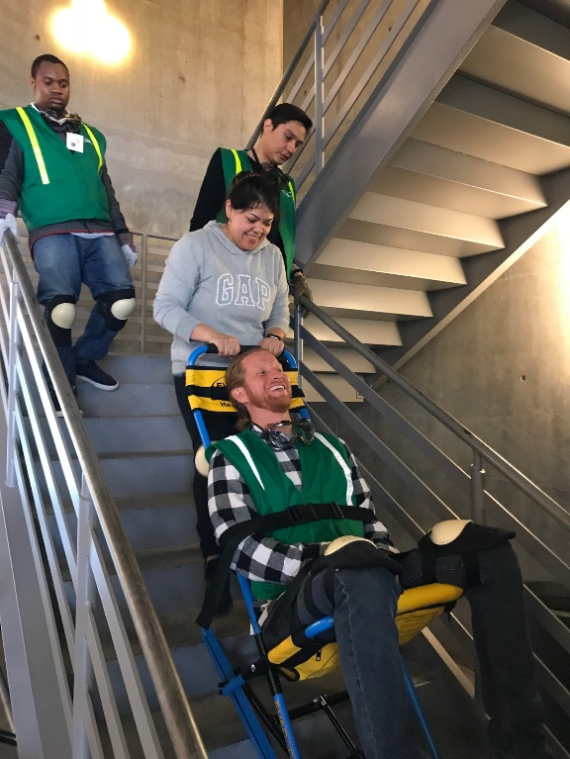
Assisting the Disabled
Use Stair Chair to descend the stairs

Slide 22
USC Basic Fire Procedure
SOUND THE ALARM
  Pulling the nearest pull station (or shout “Fire”)
LEAVE THE BUILDING IMMEDIATELY
CALL FOR HELP
  UPC 213-740-4321 or HSC 323-442-1000
MEET AT OUTDOOR ASSEMBLY AREA

Slide 23
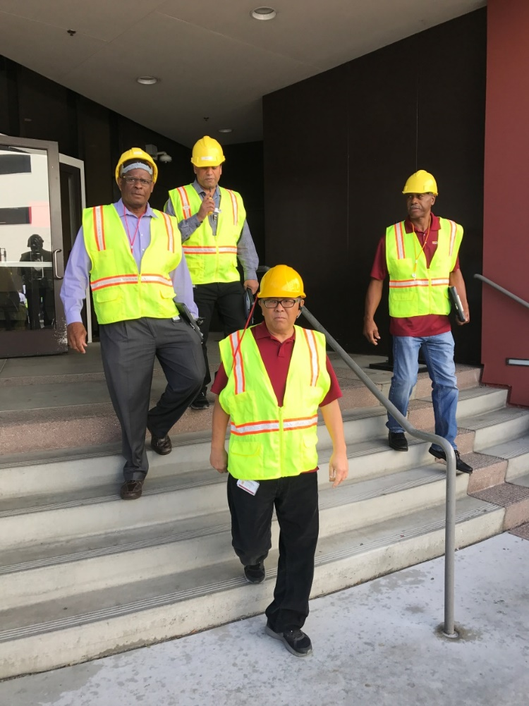
USC Building Team Response Roles
Building Evacuation Coordinator
  Act as building emergency director
  Coordinate the evacuation assembly area
  Meet arriving responders and provide evacuation status info and emergency details
Floor Wardens
  Check your specific floor or area and ensure everyone evacuates in a fire
  Check your floor as you evacuate to make sure everyone gets out
  Close doors (if time allows)
  Assist persons with disabilities

Slide 24

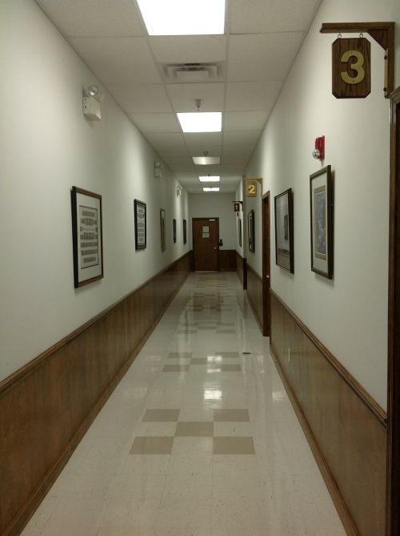
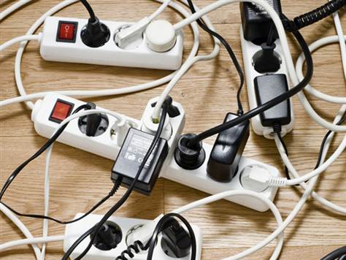
Help to Maintain Fire Safety by…
No candles
No halogen lamps or overloaded extension cords
Keep hallways clear
No tampering with fire equipment

Slide 25
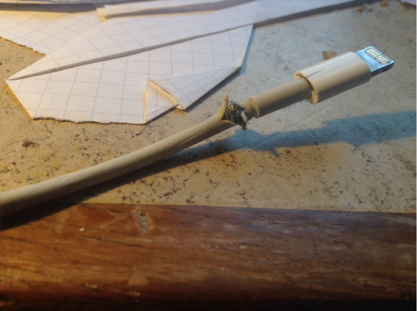
Reducing Electrical Hazards
Avoid the “electrical octopus”
Don’t run cords under carpets
Check for and replace broken or frayed cords
Maintain appliances

Slide 26
Electrical Emergencies
Know where power shutoffs are
  Appliances
  Circuit breakers
  Fuses
Post shutoff directions next to all utilities
Know procedures for turning power back on after the fire

Slide 27
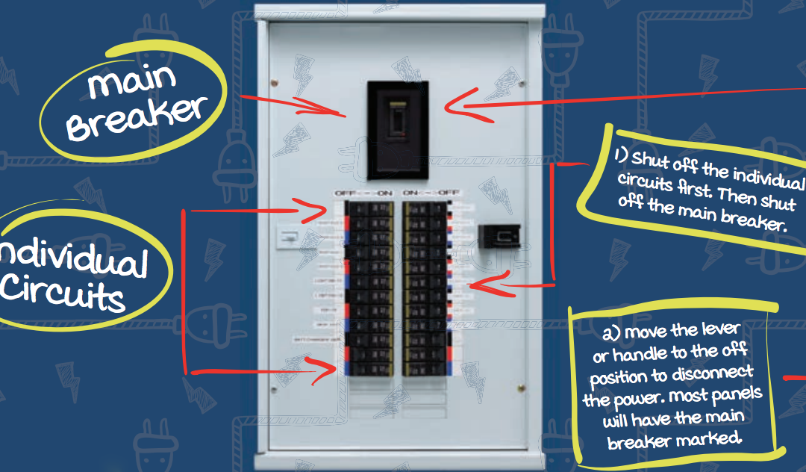
Shutoff Procedures
FIRST: Individual circuit shutoff
SECOND: Main breaker shutoff
To power back on:
FIRST: Turn on main breaker
SECOND: Turn on Individual circuits

Slide 28
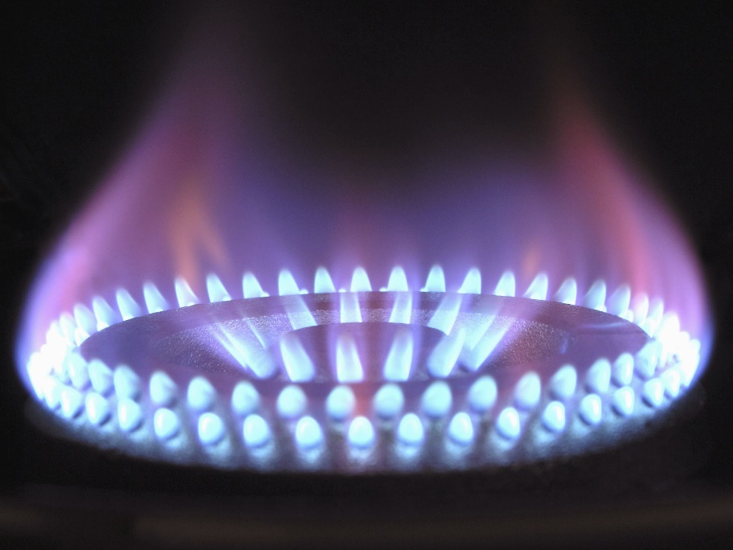
Natural Gas Hazards
Asphyxiant
  Displaces oxygen in the body
Explosive
  Can readily ignite under the right conditions

Slide 29
Natural Gas Hazard Awareness
Install natural gas detector
Install carbon monoxide detector in home
Test batteries for natural gas and carbon monoxide detectors every month
  Change batteries every six months
Locate and label gas shutoffs
  Have proper non-sparking tool

Slide 30
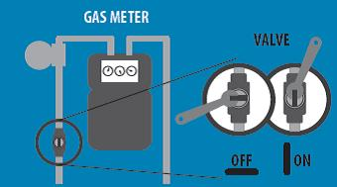
Gas Shutoff
Locate and label gas shutoff valves
If not automatic, know procedures for shutting off gas

Slide 31
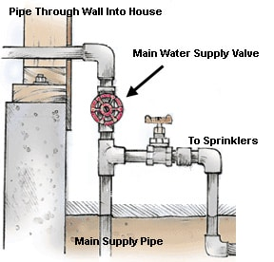
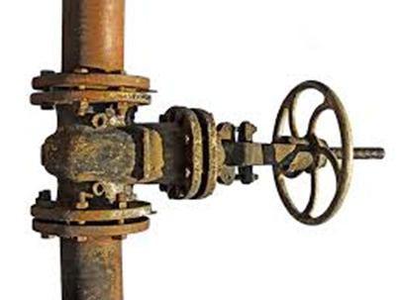
Water Shutoff
Know where to locate water shut off valves
Recognize the valve type
Shut the valve when you have determined there is no smoke or fire

Slide 32
L.I.E.S.
Always read labels
Use L.I.E.S. storage procedures
  (Limit, Isolate, Eliminate, Separate)

Slide 33
Hazardous Materials
Corrode other materials
Explode or are easily ignited
React strongly with water
Are unstable when exposed to heat or shock
Are otherwise toxic to humans, animals, or the environment through absorption, inhalation, injection, or ingestion

Slide 34
Identifying Stored Hazardous Materials
NFPA 704 Diamond White Quadrant:
  W: Shows unusual reactivity with water
  OX: Possesses oxidizing properties

Slide 35
Global Harmonized System

Slide 36
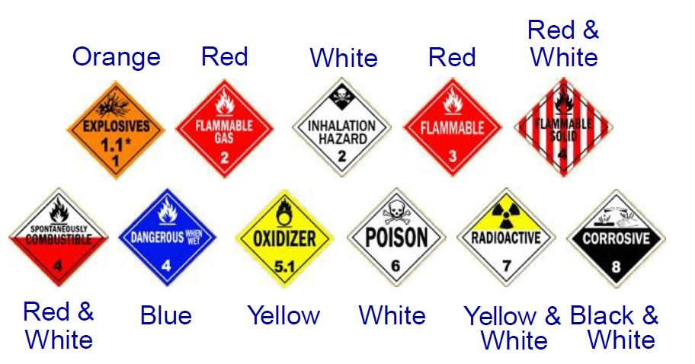
HazMats in Transit

Slide 37
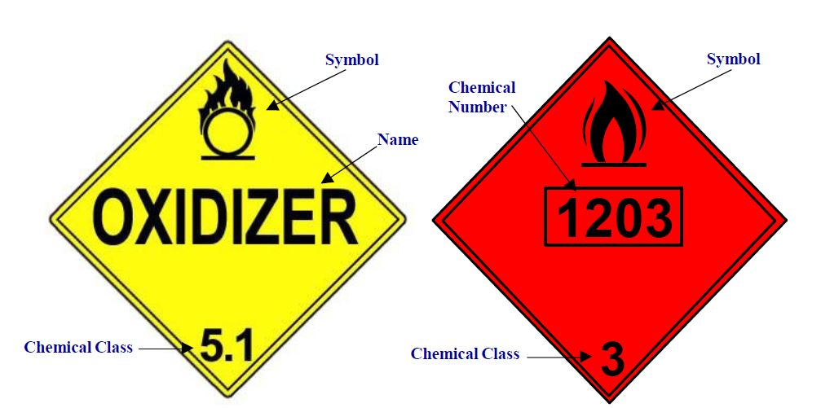
UN and NA Placards

Slide 38
Greater Than 1?
Remember:
All hazardous material placards are a stop sign for CERT volunteers!

Slide 39
Hands On….
Fire Extinguisher Training
Mini Pumper Training
Remember:
Safety First!!!

