Slide 1
CERT Basic Training
Disaster Psychology
March 27, 2023

Slide 2
Welcome and Objectives
Understand disaster trauma for survivors and rescuers
01
CINDY RYAN, PHD, MFT, CEAP, ACC
Associate Director, Clinical Services
ryancynt@usc.edu
Acquire and practice providing psychological first aid
02
Identify and commit to taking steps for personal well-being
03
TOM BADZEY, MFT, MA CLINICAL PSYCHOLOGY
Employee Assistance Professional, USC WorkWell Center
tbadzey@usc

Slide 3
Stretch Break
We invite you to move during today’s session. Stand and/or stretch in a manner that feels best for you.

Slide 4
Part I- Defining Traumatic Crisis
an event experienced or witnessed in which people’s ability to cope is overwhelmed by:
Actual or potential injury to self or others
Destruction of their homes, neighborhood, or value possessions
Loss of contact with family or close friends

Slide 5
Individual Reflection & Group Share
What traumatic crises have you or someone you know experienced?
How did it affect you/them?
What kinds of support did you/them receive?
How effective was that support?
What other kinds of support would you have wanted?

Slide 6
Causes of Disaster Reactions
Feeling unsafe and insecure
Working in your neighborhood
Dealing with your own personal losses
Assisting neighbors, friends, or coworkers who have also been injured

Slide 7
The Five Fs of Trauma Response
Freeze
“Stop, look, and listen,” or be on guard and watchful
01
02
Flight
Flee
03
Fight
Attempt to combat the threat
04
Fright
Tonic immobility when in contact with a predator, or playing dead
05
Faint
Fear-induced fainting

Slide 8
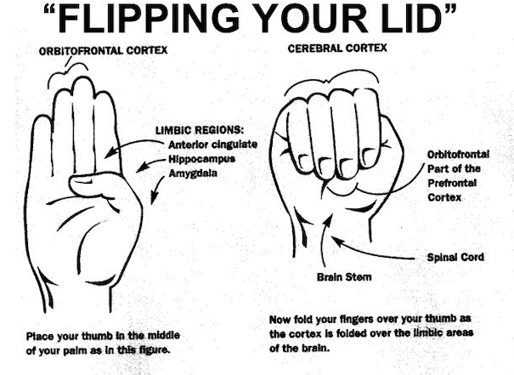
One More “F” … Flipping Your Lid
06
Flipping your lid
Dr. Dan Siegel, author and neuroscientist
What’s going on in the brain when trauma occurs
What the brain can and can’t do
What you need: stabilizing, soothing support
Get the prefrontal cortex back online

Slide 9
Symptoms of Psychological Trauma
How would you know?
Physical Signs
Emotional Signs
Cognitive Signs
Spiritual Signs

Slide 10
Physical Signs of Trauma
Loss of appetite
Headaches or chest pain
Diarrhea, stomach pain, or nausea
Hyperactivity
Increase in substance use
Nightmares
Insomnia
Fatigue
Physical Signs

Slide 11
Emotional Signs of Trauma
Emotional distress – reactive and/or hypervigilant
Irritability/aggression
Blame and guilt
Flat affect (void of responses)
Feeling detached (dissociation)
Feeling isolated/cut off
Emotional Signs

Slide 12
Cognitive Signs of Trauma
Concentration
Focus
Memory
Derealization & depersonalization
Negative thoughts (totalizing, generalizing)
Cognitive Signs

Slide 13
Spiritual Signs of Trauma
Disillusionment
Loss of Faith
Existential crisis
Increased spirituality/religiousness
Spiritual Signs

Slide 14
Stretch Break
We invite you to move during today’s session. Stand and/or stretch in a manner that feels best for you.

Slide 15
Part II- Emotional Phases of a Crisis
Pre-Disaster
Impact
Heroic
Honeymoon
Disillusionment
Reconstruction

Slide 16
Mediating Factors
05
03
Length of time since event
Individual feelings about event
01
Prior experience with a similar event
04
Emotional strength of individual
02
Intensity of disruption

Slide 17
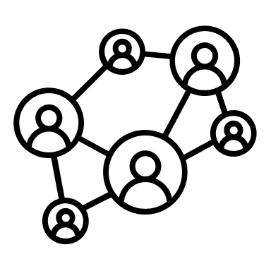
Stabilizing Factors
01
02
03
04
Assess survivors for injury or shock
Get uninjured people to help
Provide support by listening and empathizing
Help survivors connect with natural support systems

Slide 18
Listen, Protect, Connect
LISTEN
Listen to survivors and pay attention to what they say
Protect
Help survivors feel protected by providing support
CONNECT
Connect survivors to friends and loved ones

Slide 19
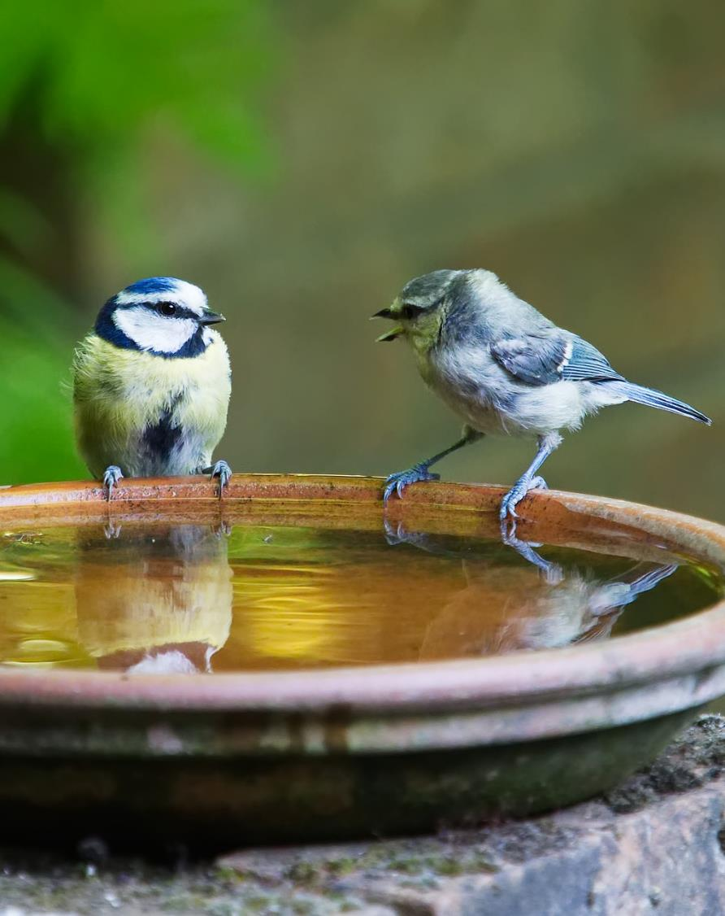
How to Be an Empathetic Listener
Empathy
Put yourself in the speaker’s shoes
listen
Listen for meaning, not just words
Pay attention
Pay attention to nonverbal communication
paraphrase
Paraphrase the speaker

Slide 20
What To Say
“Don’t feel bad”
“It’s God’s will”
“I understand”
“It could be worse ”
“I’m sorry for your pain”
“You’re strong”
“At least you still have…”
“I can’t imagine what this is like for you”
“You’ll get through this”
“I’m so sorry this has happened”
“Everything will be okay”
“Don’t cry”
“What do you need?”
“Is it all right if I help you with…?”
Lead with open-ended questions when possible

Slide 21
Let’s Try it out
Role Play Activity

Slide 22
Stretch Break
We invite you to move during today’s session. Stand and/or stretch in a manner that feels best for you.

Slide 23
Part III- Individual & Team Well-Being
Actions can be taken before, during, and after an incident to help manage emotional impact of disaster response work
Knowing possible psychological and physiological symptoms of disaster trauma helps manage impact
Learn to manage stress:
CERT volunteers for themselves
CERT leaders during response

Slide 24
How to Reduce Stress
Exercise regularly
Get enough sleep
Balance work, play, and rest
Allow yourself to receive as well as give
How to Reduce Stress
Eat a balanced diet
Connect with others
Use spiritual resources

Slide 25
Take Care of Yourself
Be aware of trauma that can follow a disaster
Explain to family members and friends what you need:
Listen when you want to talk
Don’t force yourself to talk until you are ready

Slide 26
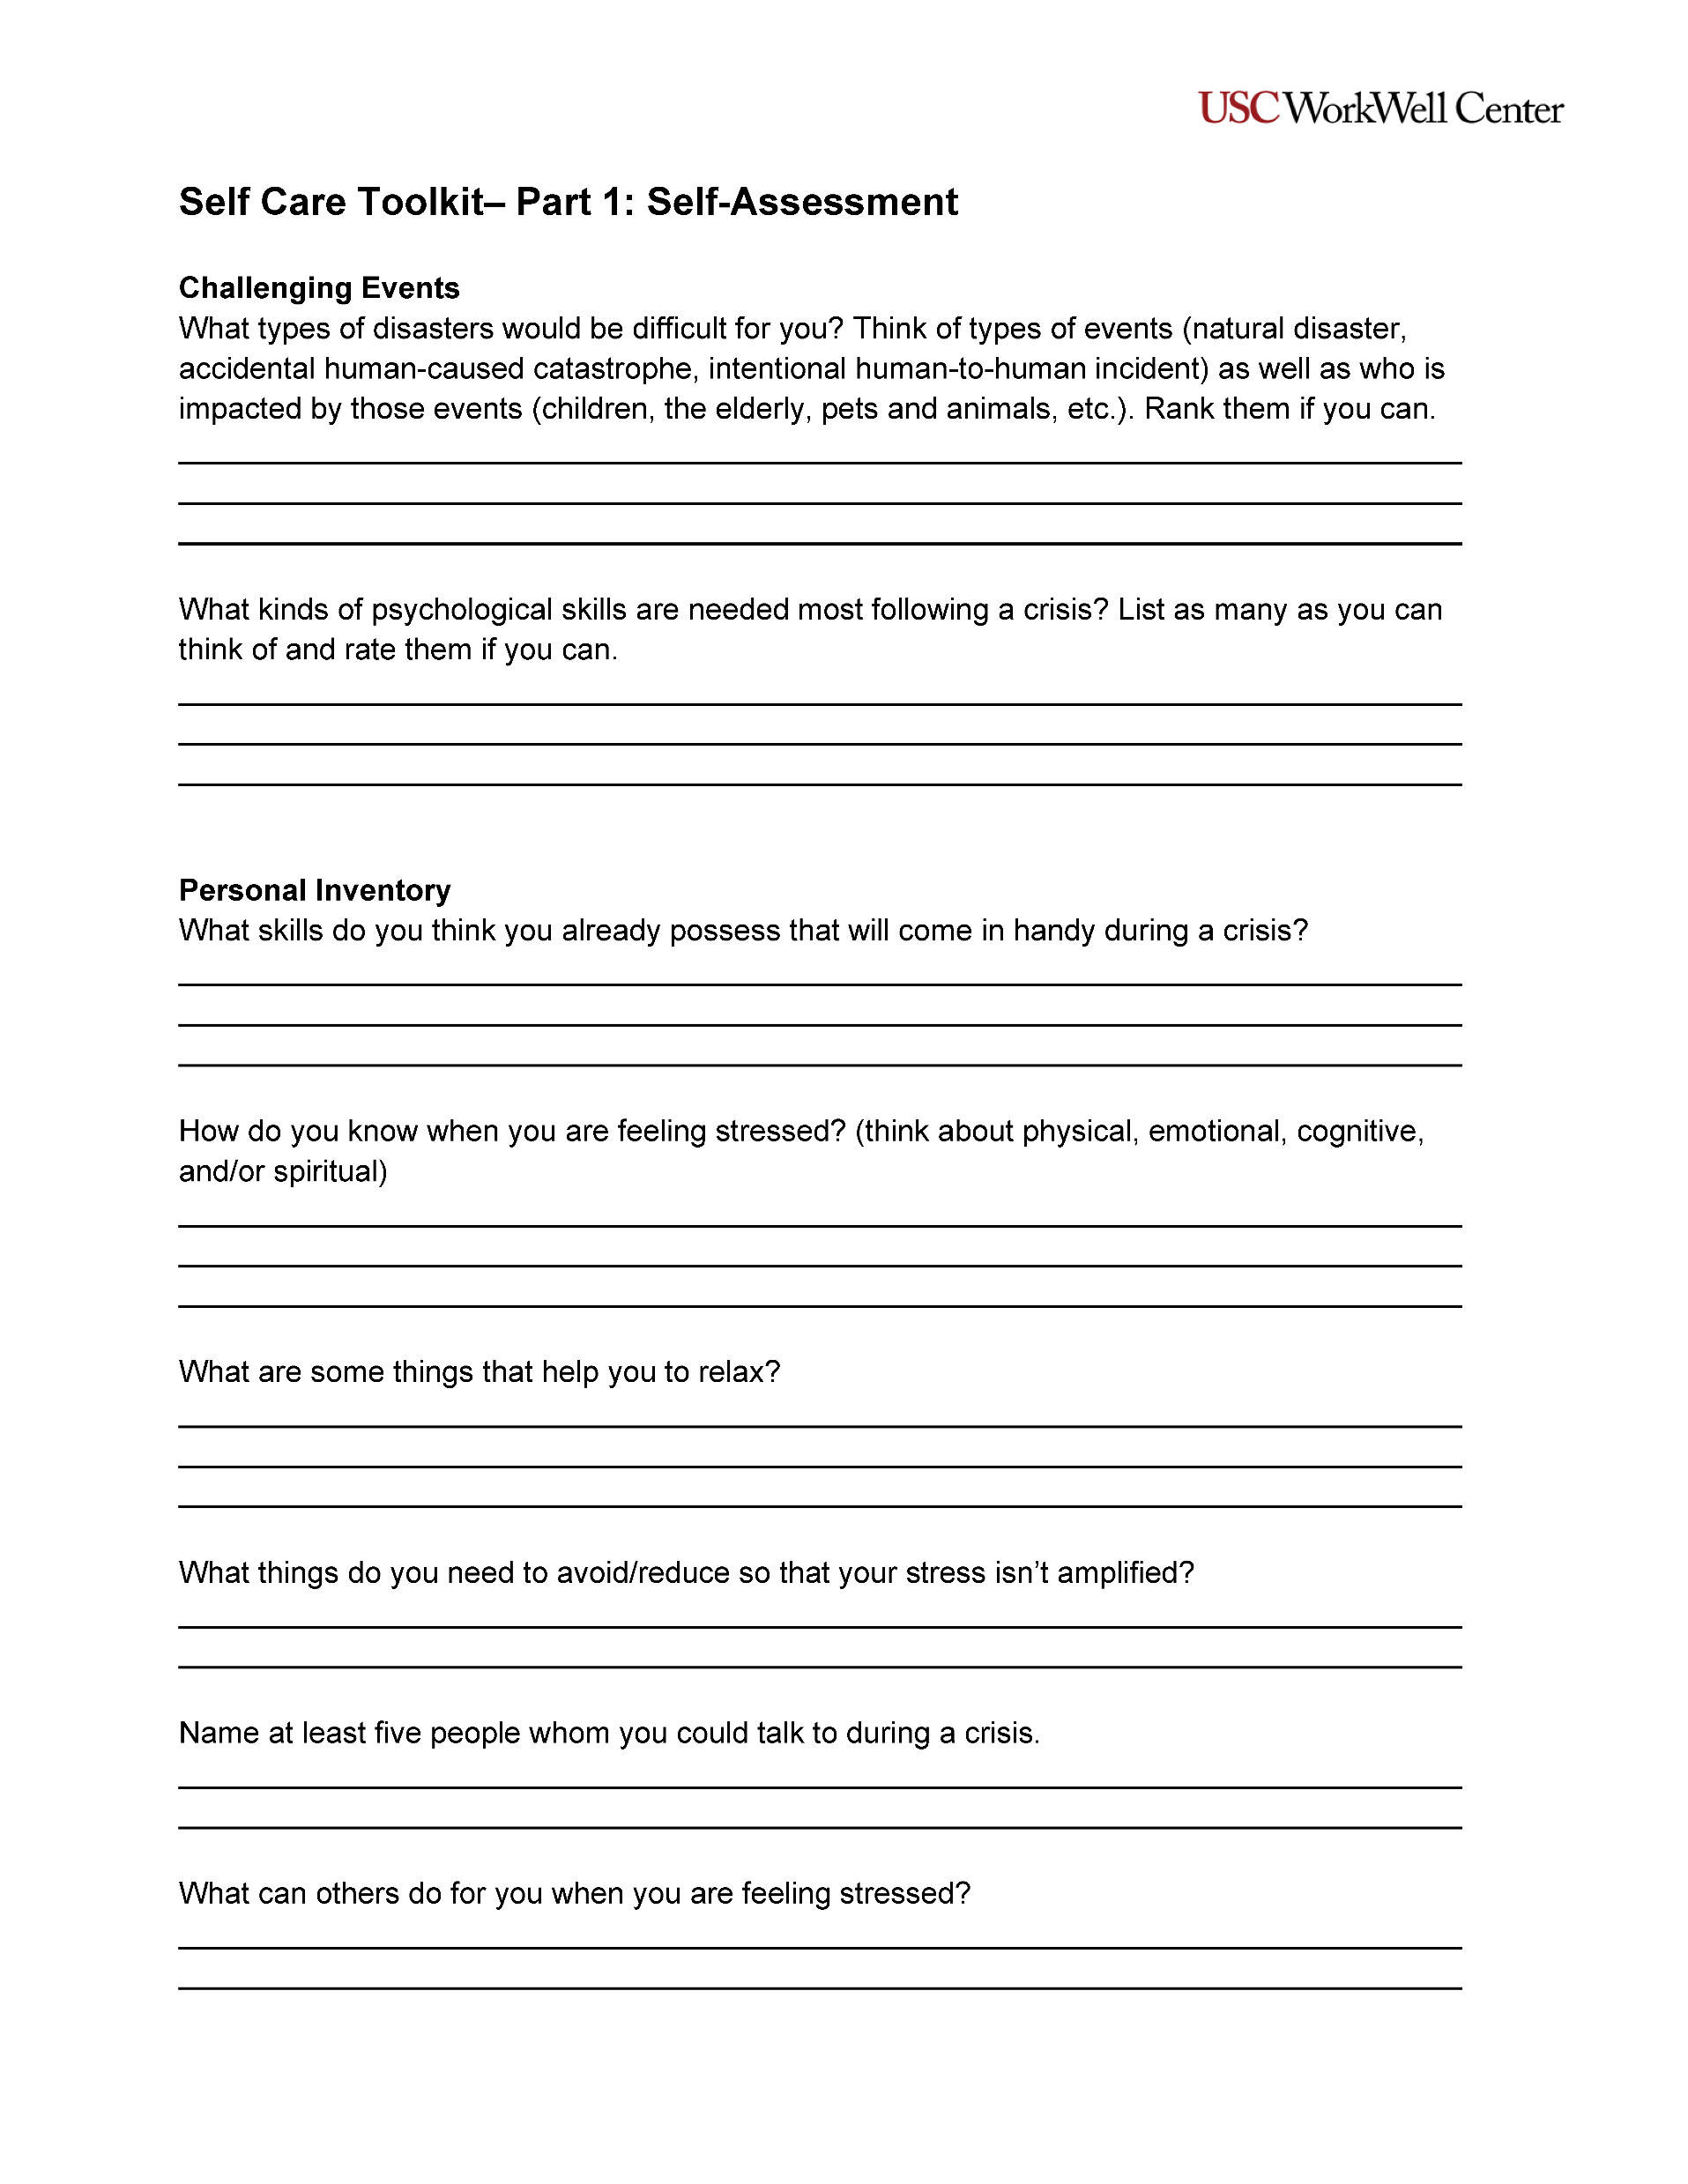
Self-Care Toolkit– Part 1: Self-Assessment
This activity provides you with the opportunity to identify self-care tools you can use before and during a crisis so that you are ready to respond during an emergency
Complete this exercise individually and at your own pace. When everyone has finished, you will have the opportunity to share your responses with the class if you would like
Please take about 5 minutes to complete Part 1 of the Self-Care Toolkit Worksheet

Slide 27
Pair Share
Self-Care Toolkit– Part 1
What did you notice?
How did you feel?

Slide 28
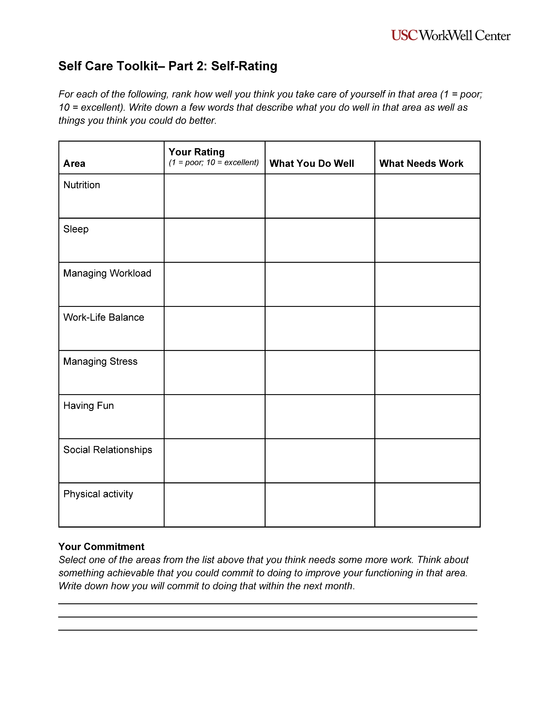
Self-Care Toolkit – Part 2: Self-Assessment
This activity provides you with the opportunity to identify self-care tools you can use before and during a crisis so that you are ready to respond during an emergency
Complete this exercise individually and at your own pace. When everyone has finished, you will have the opportunity to share your responses with the class if you would like
Please take about 5 minutes to complete Part 2 of the Self-Care Toolkit Worksheet

Slide 29
Pair Share
Self-Care Toolkit– Part 2
What areas are you strong with?
What areas need more help?
What can you commit to changing within the next month?

Slide 30
How Team Leaders Reduce Stress
Brief CERT personnel beforehand
Remember CERT is a team
Rest and regroup
Take breaks away from the incident site
Establish a culture of acceptance
Eat properly, stay hydrated
Be aware of changes in teammates
Rotate teams and duties
Phase out workers gradually
Defuse after shift

Slide 31
Unit Summary
Prepare yourself
stabilize
Prepare yourself, as rescues may be unpleasant and uncomfortable
Stabilize individuals
Know the symptoms
Listen, protect, connect
Know the psychological and physiological symptoms of trauma
Listen, protect, and connect to support survivors
empathy
Understand emotions
Be an empathetic listener
Understand the six emotional phases of a disaster
Reduce stress
Take steps to reduce stress, which affects cognition, health, and interactions

Slide 32
Programs & Services
Serving Faculty, Staff, Post-docs | Cost-free, Confidential, Convenient
Learn more at workwell.usc.edu | Call all us 24/7 at 213-821-0800 | Email us at WorkWell@usc.edu

Slide 33
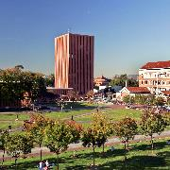
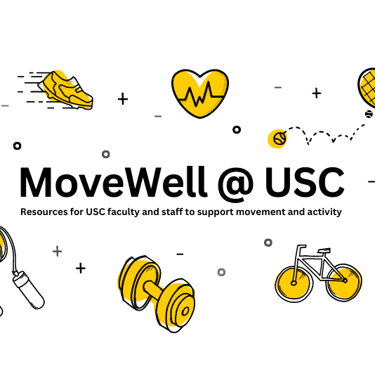
Current and Upcoming Programs
Parent Connect Group
Resources for working parents to connect on our Slack Channel or drop-in group held every Wednesday at 12:15PM. email us: workwell@usc.edu for more information.
USC Healthy Campus
A comprehensive, collaborative, and long-term strategy to support the health of our Trojan Community across all domains of well-being.
WalkUSC
An on-campus walking program led by trained volunteer faculty and staff aimed at creating a culture of movement and social connection through group activity.
Mental Health Awareness Month
A 5-week webinar series for USC faculty and staff to elevate mental health awareness and support at USC.
Health & Well-being Resources
Visit our website for Health & Well-Being Resource Directory 2023, the WorkWell Guide, archives of webinars and talks, and tip sheets.
MoveWell at USC
Programs and resources to help USC faculty and staff move more throughout the day
Learn more at workwell.usc.edu

Slide 34
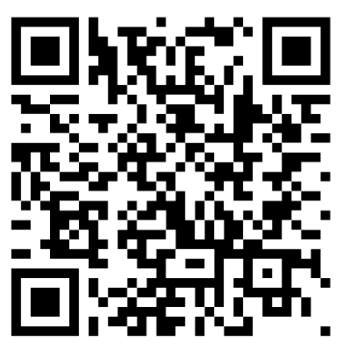
Scan the QR code to sign up
Join our Mailing List!
Sign up to receive announcements from the WorkWell Center
Learn more at workwell.usc.edu
34

Slide 35
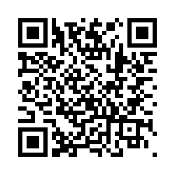
Scan the QR code to access
Evaluation Survey
Give us
Feedback!
Please access the 10-item questionnaire to provide feedback and evaluation.
Learn more about our services at workwell.usc.edu
35
Notes:
https://usc.qualtrics.com/jfe/form/SV_3JXWQbIj6qotKFU
This is for the general WorkWell survey.

Slide 36
Thank You!

