Slide 1
Disaster Preparedness
USC CERT Basic Training

Slide 2
Unit Objectives
Describe the functions of CERT, discuss your role as a CERT volunteer, and explain how CERT fits into your community’s emergency preparedness structure
Describe the types of hazards most likely to affect your communities and their potential impact on people, health, and infrastructure
Prepare yourself and your family for potential disasters your community may face, including learning to create a family disaster plan and emergency preparedness kit

Slide 3
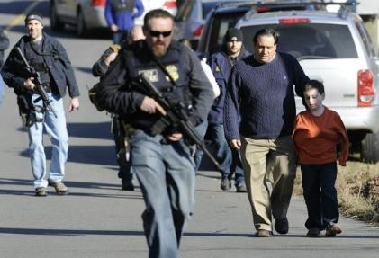
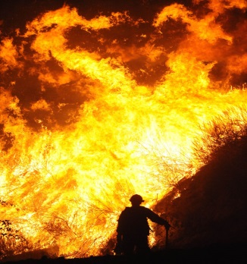
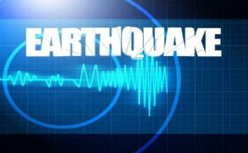
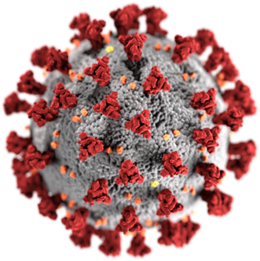
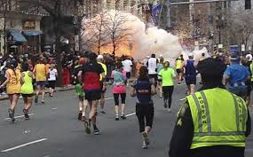
Setting the Stage
Disasters are inevitable:
Most people are unprepared
Emergency personnel may be overwhelmed
Lives, health and the environment are in danger
School Shooting
Wildfire
Earthquake
Pandemic
Terrorism

Slide 4
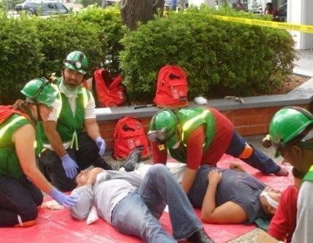
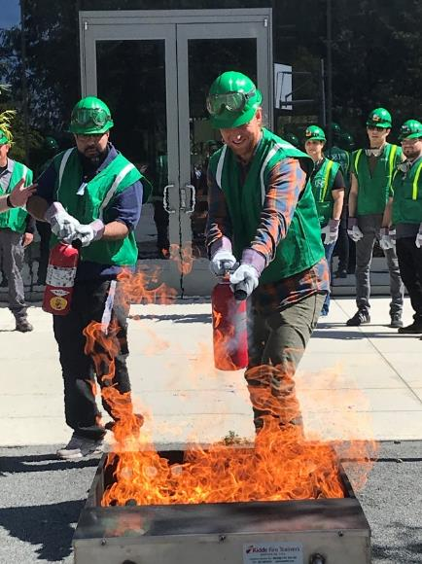
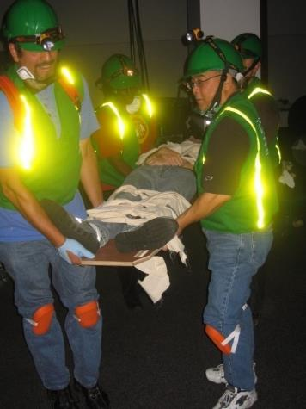
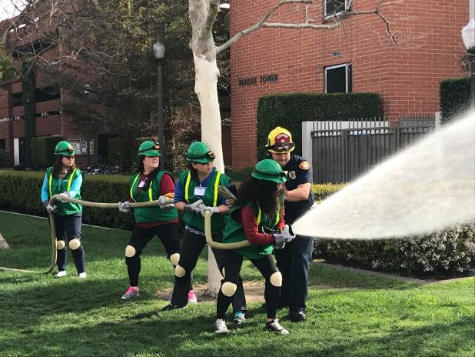
Setting the Stage
But…. You are here to learn the skills you need to be well prepared to assist the USC Community, your family, your neighborhood, and possibly even your city!

Slide 5
Setting the Stage
USC CERT Mission:
The USC Campus Emergency Response Team (CERT) program is a team of staff and faculty volunteers trained in disaster response, fire safety, light search & rescue, disaster medical operations and other skills. The team serves as a force multiplier to other emergency response teams on campus to support critical response operations following a major emergency or disaster. Team members are also able to support their local communities.

Slide 6
Setting the Stage
Your # 1 Job:
Take care of yourself first
Help others on campus, community, neighborhood
You are #1!!! YOUR safety is always the first priority!!!

Slide 7
Get Involved
Preparedness requires active participation from all
Talk to friends and family about hazards
Ask about emergency planning outside at work
Make sure you always have a plan
Training provides skills needed to help others and keeps skills current
CERT program provides training, practice, and connection to others
Participate in drills and exercises
Talk to friends and family about volunteering in their city

Slide 8
Types of Disasters
Natural (e.g., earthquakes, wildfires, floods, extreme heat, hurricanes, landslides, thunderstorms, tornadoes, tsunamis, volcanic eruptions, winter storms)
Technological & Accidental (e.g., hazardous material spill, nuclear power plant accident)
Terrorism (e.g., chemical, biological, radiological, nuclear, explosive weapons)

Slide 9
Key Disaster Elements
They are relatively unexpected
Emergency personnel may be overwhelmed
Lives, health, and the environment are endangered

Slide 10
Local Hazard Vulnerability
Identify most common disasters that occur
In California: Earthquakes & Wildfires
Identify possible hazards with most severe impact
Consider recent or historical impacts
Identify susceptible locations in the community for specific hazards
Consider what to expect from disruption of services

Slide 11
Infrastructure Damage
Resources will be applied to the highest priority need:
Police will address incidences of grave public safety
Firefighters will suppress major fires
EMS personnel will handle life-threatening injuries

Slide 12
Damage Related to Structure Type
You may not have opportunity to select type of structure when a disaster occurs
Engineered buildings have performed well in most types of disasters
Types of damage vary by structure
Differences in hazards and mitigation between single-family homes and multiple-unit dwellings

Slide 13
Home Hazards
Gas line ruptures from water heaters or ranges displaced by shaking, water, or wind
Damage from falling books, dishes, or other cabinet contents
Risk of injury or electric shock from displaced appliances and office equipment
Fire from faulty wiring, overloaded plugs, frayed electrical cords

Slide 14
Preparing for a Disaster((2 of 2)
Know local hazards, alerts, warning systems, evacuation routes, and sheltering plans
Consider important elements of disaster preparedness
Address specific needs for yourself and people you know

Slide 15
Preparing for a Disaster((2 of 2)
Have the skills to evaluate the situation quickly and take effective action to protect yourself
Have a family disaster plan and practice the plan with drills
Assemble supplies in multiple locations
Reduce the impact of hazards through mitigation practices
Get involved by participating in training and volunteer programs

Slide 16
Earthquakes
Overall Earthquake Risk:
75 million Americans in 39 states face significant risk
Residents of California face the highest risk followed by WA
90% probability of a major earthquake in southern California in the next 20 years
Almost every area of the region will experience strong ground shaking at some point

Slide 17
Earthquakes
Southern California has over 300 active faults

Slide 18
Earthquakes

Slide 19
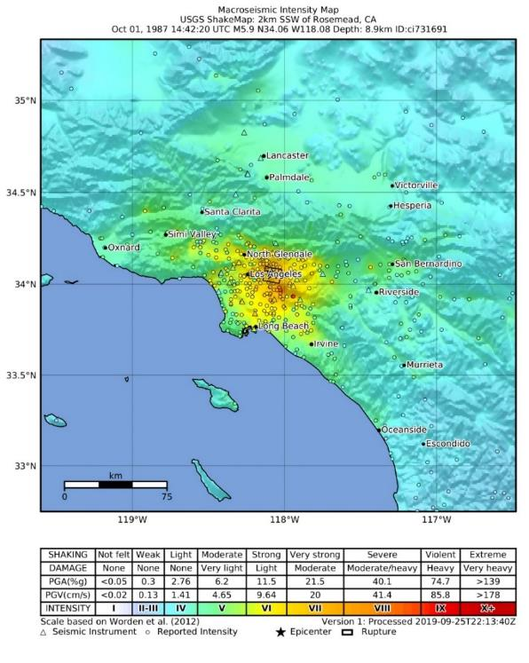
Earthquakes
Whittier Narrows Earthquake Facts
1987, 7:42 am
Magnitude 5.9
Strong shaking near epicenter
20 Seconds
8 deaths
Damage was estimated at 100 million

Slide 20
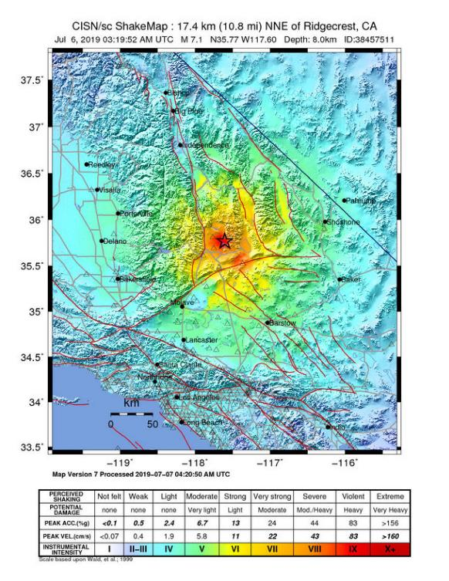
Earthquakes
Northridge Earthquake Facts:
Jan. 17, 1994
Magnitude 6.7
Strong shaking near epicenter
7 Seconds
Over 40,000 Injured
57 deaths

Slide 21
Earthquakes
Ridgecrest Earthquake Facts:
July 5, 2019
Magnitude 7.1 with 6.4 and 5.4
Strong shaking near epicenter
7 Seconds
25 Injured
1 death

Slide 22
Earthquakes
Magnitude | Intensity | Description
1.0 – 3.0 | I | Not felt.
3.0 – 3.9 | II – III | Felt indoors & on upper floors, but most do not recognize it as an earthquake.
4.0 – 4.9 | IV – V | Felt by nearly everyone, may awaken at night, “stuff “disturbed, walls may make cracking noise.
5.0 – 5.9 | VI – VII | Felt by all, many frightened. Slight damage in well built buildings, considerable damage in poorly built/designed buildings. Some chimneys may break.
6.0 – 6.9 | VII – IX | Damage considerable, plumb issues, shifting off foundation, heavy furniture overturned.
7.0 and higher | VII or higher | Well-built wooden structures destroyed, masonry structures, & bridges destroyed, rails bent.

Slide 23
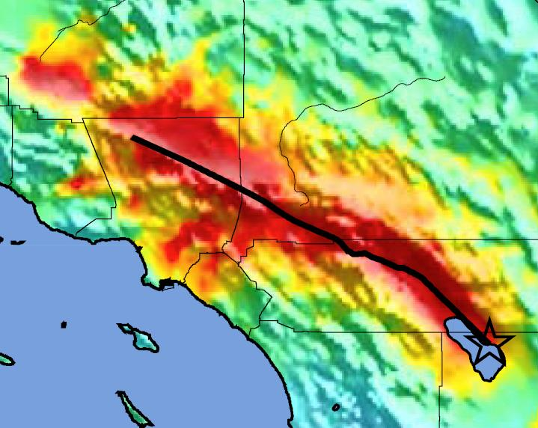
Earthquake – Prediction
7.8 Magnitude San Andreas Fault EQ:
Geographically widespread
Strong ground shaking
Duration 1 – 2 minutes
OVERDUE!!!
Expectations:
300,000 buildings damaged
1,800 fatalities
53,000 injured
255,000 homeless
1,600 FIRES
$200-$300 Billion in damage
Bakersfield
Los Angeles
Riverside
Mag 7.8 ShakeOut Scenario Earthquake Instrumental Intensity

Slide 24
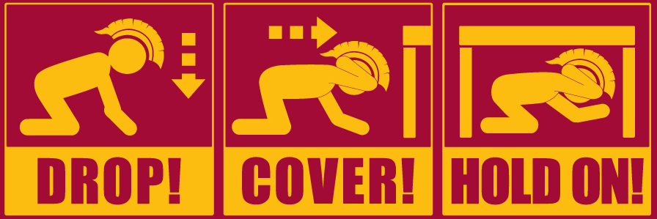
Earthquake Response

Slide 25
Earthquake Response
What NOT to do:
Panic
RUN
Take shelter in a doorway

Slide 26
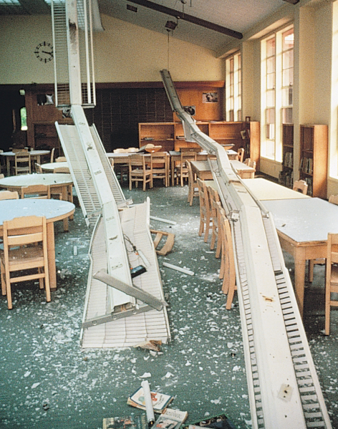
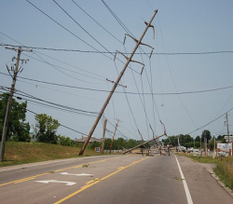
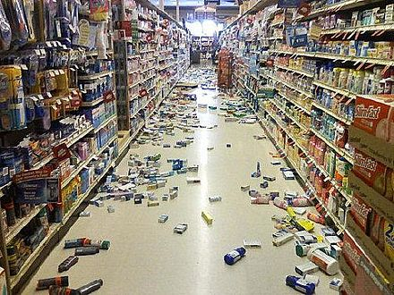
Earthquake Response
Hazards to be aware of:
The main hazard is falling objects
Smell of smoke or fire
Down power lines

Slide 27
Earthquake Response
WHAT IF….
You are at home?
You are in bed?
You are at work?
You are at Costco?
You are in a grocery store?
You are driving?

Slide 28
Earthquake Preparedness
Keep shoes and a flashlight under the bed
Secure bookshelves, water heaters, and tall furniture to wall studs
Install latches on all cabinets, and anchor overhead lighting fixtures
Secure items that might fall, such as televisions
Store heavy and breakable objects on low shelves

Slide 29
Earthquake Preparedness
Move beds away from windows
Move or secure hanging objects over beds, couches, and other places where people sit or lie
Have a licensed professional install flexible pipe to avoid gas or water leaks

Slide 30
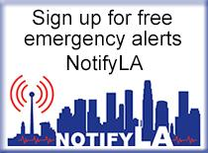
Earthquake Preparedness
Have a communication plan
Maintain a paper contact list – with out of state contacts
Join your city or county emergency alert system
Make sure you receive USC TrojansAlert

Slide 31
Earthquake Preparedness

Slide 32
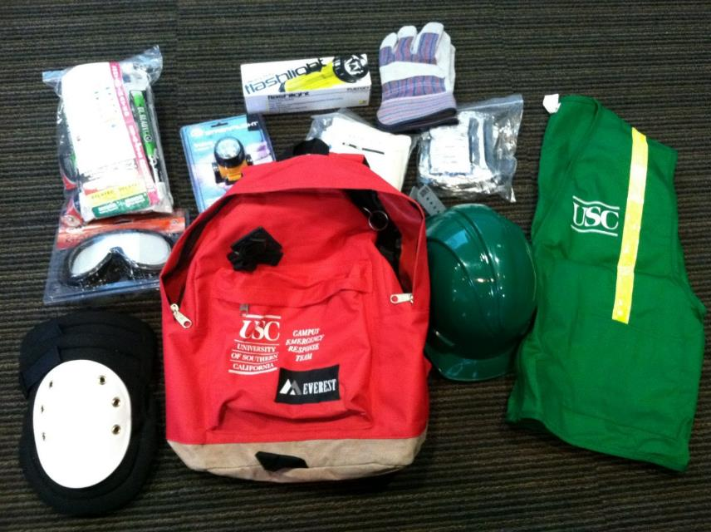
Personal Protective Equipment
Helmet/Head lamp
Goggles
N95 Mask
Gloves (work and non-latex)
Flash light
Knee pads
First Aid Supplies
Triage tags
Sturdy shoes or work boots

Slide 33
Family Disaster Plan
Where will you meet family members?
Who is your out-of-state “check-in” contact?
Will you have an extended stay? Shelter in place? Evacuate?
How will you escape your home? Workplace? School? Place of worship?
What route (and several alternates) will you use to evacuate your neighborhood?
Do you have transportation?
Did you practice your plan?

Slide 34
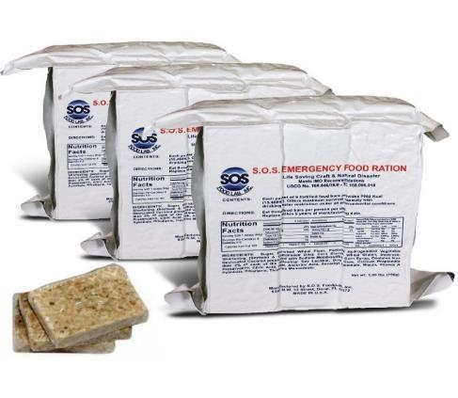
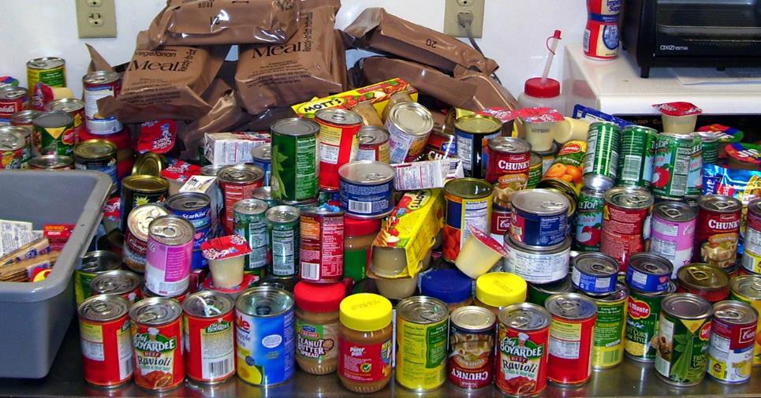
Earthquake Supplies
Food
Foods that you normally eat
Canned food – can opener
Low sodium
Comfort Food

Slide 35
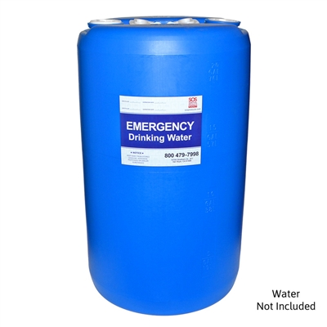
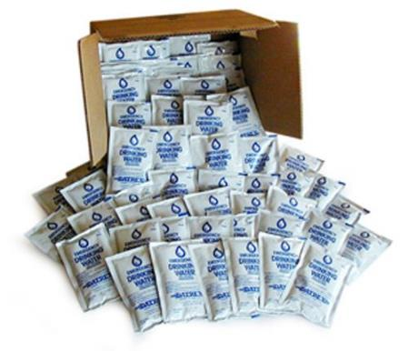
Earthquake Supplies
Water
FEMA recommends 1 gallon a day per/person for drinking & 1 gallon a day for sanitation
Rotate water supplies every 6 months
Be ready to purify water
mixture of 8 drops of bleach to a gallon of generally clear water for best a

Slide 36
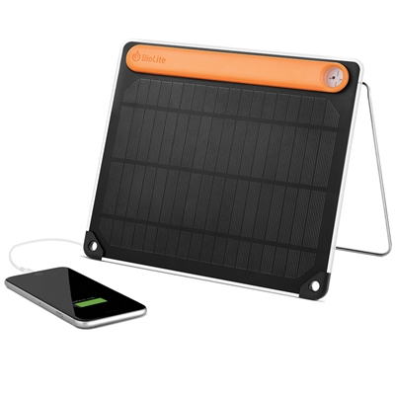
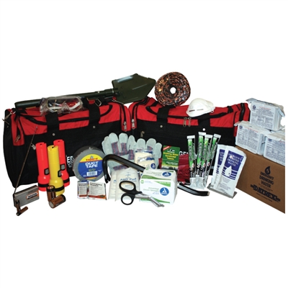
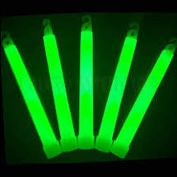
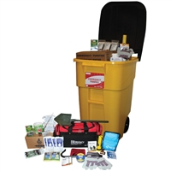
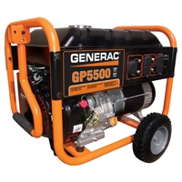
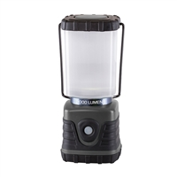
Earthquake Supplies
Supplies for your home kit
Flashlight/batteries; glow sticks
Transistor radio
Work gloves
Eye protection
Tools – pry bar
Gas shut off wrench
First aid supplies
Generator – solar charger
BBQ

Slide 37
Earthquake Supplies
Essential Medicines:
Minimum 2 week supply
Never take the last one
Prescription glasses
Critical Papers:
Insurance, bank, medical records
Cash – low denominations

Slide 38
Mitigation
Mitigation is the reduction of loss of life and property by lessening the impact of disasters and includes any activity that prevents an emergency or reduces effects of hazards
CERT members should have adequate homeowners coverage
Add flood insurance if in a flood hazard area
Earthquake Insurance?

Slide 39
Structural Mitigation Measures
Bolt houses to foundations
Strap propane tanks and chimneys
Strap mobile homes to their slabs
Raise utilities

Slide 40
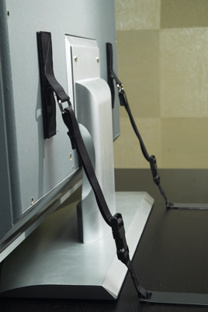
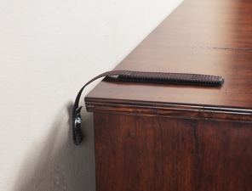
Non-Structural Hazard Mitigation
Anchor heavy furniture
Secure appliances and office equipment
Childproof cabinet doors
Museum Wax or earthquake putty for small items
Locate and label gas, electricity, and water shutoffs
Secure water heaters and have flexible gas lines installed

Slide 41
CERT Disaster Response
CERTs respond post-disaster by:
Treating life-threatening injuries until professional assistance is available
Helping disaster survivors cope with their emotional stressors
Locating and turning off utilities, if safe to do so
Extinguishing small fires
Conducting light search and rescue operations

Slide 42
CERT Organization
CERT Team Leader
Logistics Chief
Operations Chief
DPS/CP
Fire Suppression
Medical
Search & Rescue
Communications
Planning Chief
Incident Status
Documentation

Slide 43
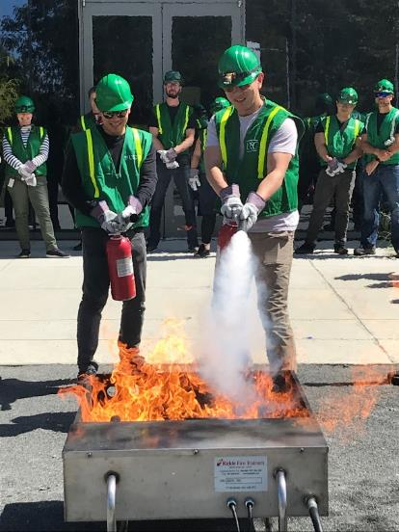
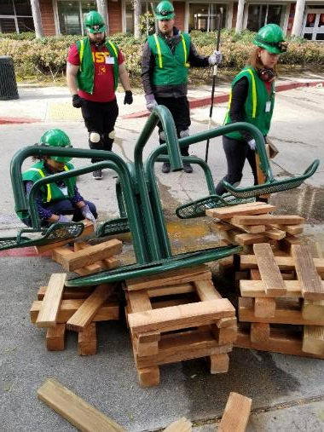
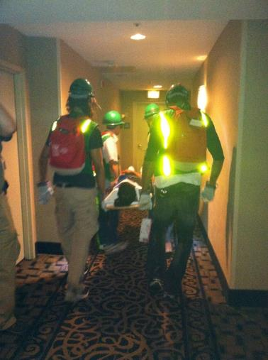
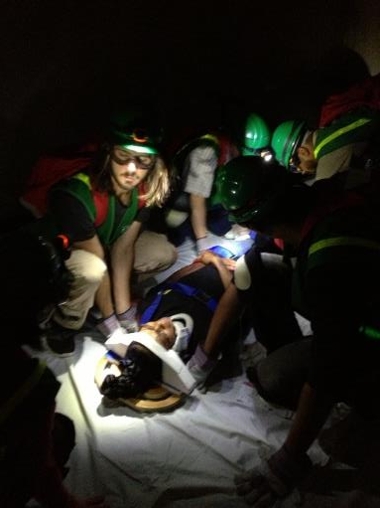
USC CERT in Action

Slide 44
Non-Disaster Roles
Assist with special events
CONQUEST
Commencement – wheelchair distribution
Conduct Fire Extinguisher Training at USC Annual Emergency Preparedness Fair
Promote CERT at USC Emergency Preparedness Fair

Slide 45
Protection for Disaster Workers
CERT members are generally protected by:
“Good Samaritan” laws
Volunteer Protection Act of 1997
Relevant State statutes
USC Workers Compensation

Slide 46
Additional Training & Resources
https://community.fema.gov/PreparednessCommunity/s/welcome-to-cert
https://www.ready.gov/resources

