Slide 1

Disaster Medical Operations – Part 2
USC CERT Basic Training

Slide 2
Unit 4 Objectives
Triage
Perform head-to-toe patient assessments
Take appropriate sanitation and hygiene measures to protect public health
Explain the role of the CERT volunteer during a mass casualty incident
Describe the functions of disaster medical operations
Describe how to set up survivor treatment areas

Slide 3
What is Triage?
Triage is a process of managing and sorting of patients during a mass casualty incident:
  - Patients are sorted based off RPM
    Respirations, Perfusion, and Mental Status
    - Urgency of need
    - Tagged Immediate, Delayed, Minor
    It is a French word that means to sort.

Slide 4
What is Triage?
Triage is a process of managing and sorting of patients during a mass casualty incident:
  - Patients are sorted based off RPM
    Respirations, Perfusion, and Mental Status
    - Urgency of need
    - Tagged Immediate, Delayed, Minor
    It is a French word that means to sort.

Slide 5
Triage Process
Step 1: Stop, Look, Listen, and Think
Step 2: Conduct voice triage
Step 3: Start where you stand; follow systematic route
Step 4: Evaluate each victim and tag
Step 5: Treat “I” victims immediately
Step 6: Document triage results

Slide 6
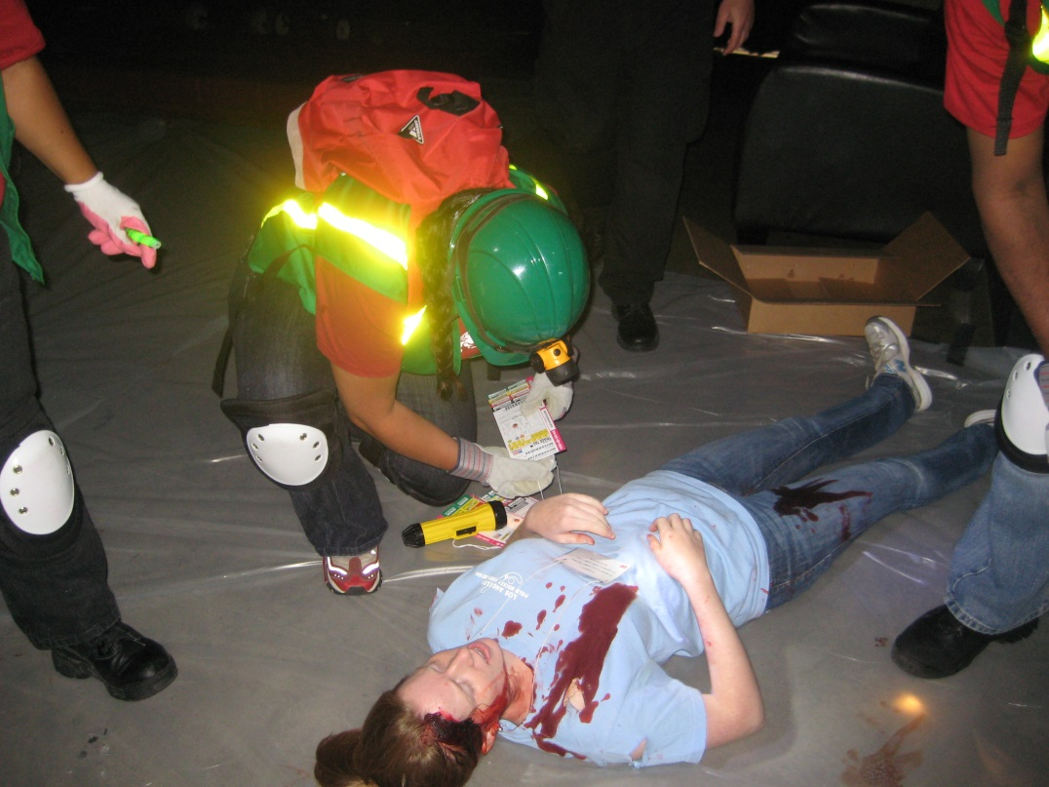
Triage Process
Check RPM
  Respirations – Open airway, check breathing
  Perfusion – Capillary Refill, pulse; Circulation & bleeding
  Mental Status – Ask questions; Alert & oriented

Slide 7
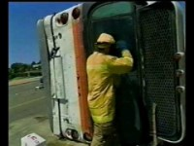
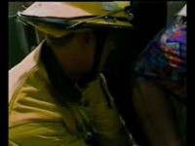
Triage Video
Part 1: https://www.youtube.com/watch?v=73kJ-4gEsnA
Part 2: https://www.youtube.com/watch?v=4NHSAZW0d5Y

Slide 8

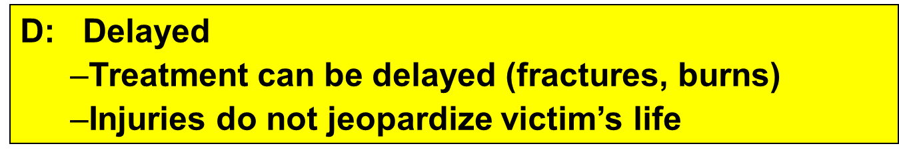

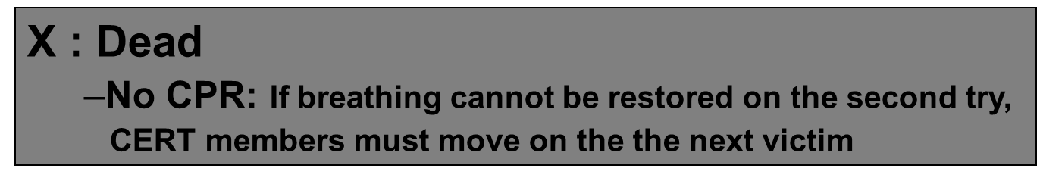
Triage Categories

Slide 9
Triage Tests - RPM
Respiration
  >30bpm = IMMEDIATE
Perfusion: Capillary Blanche
  >2sec = IMMEDIATE
Mental Status
  Unconscious = IMMEDIATE
  Can’t follow simple command = IMMEDIATE

Slide 10
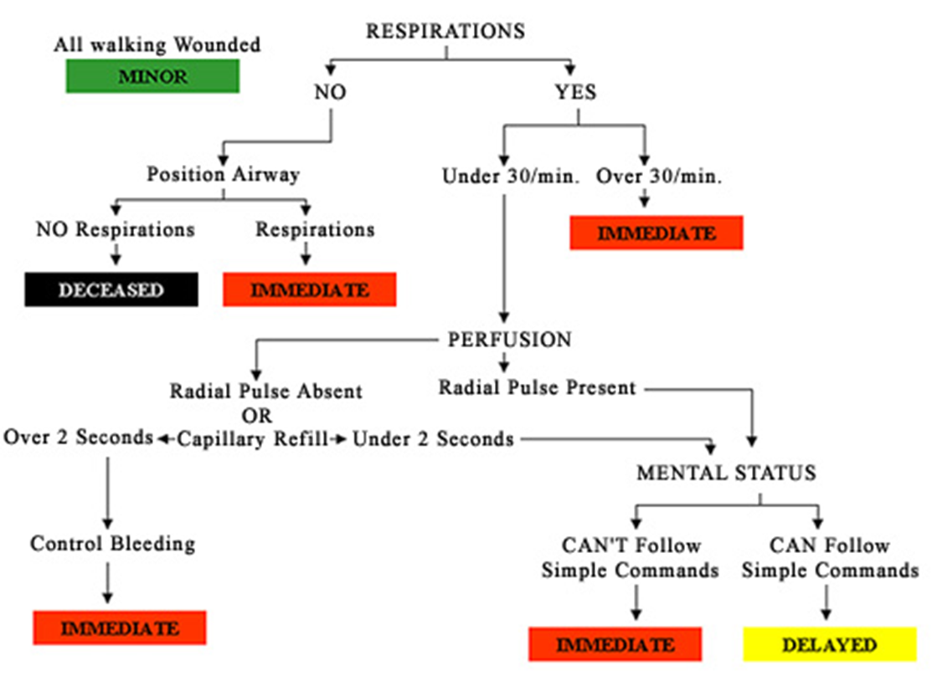
Triage Decision Tree

Slide 11
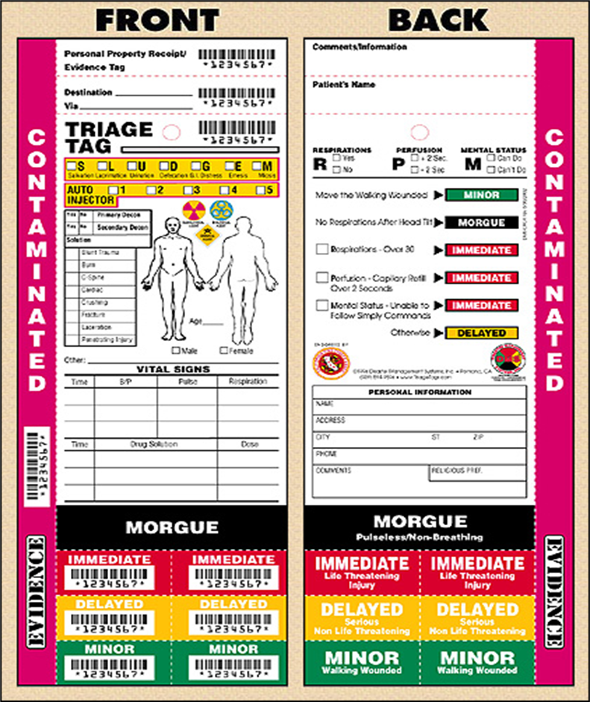
Triage Tag

Slide 12
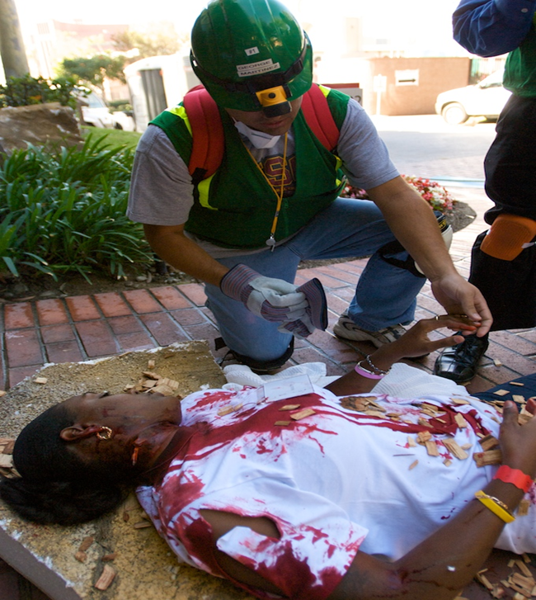
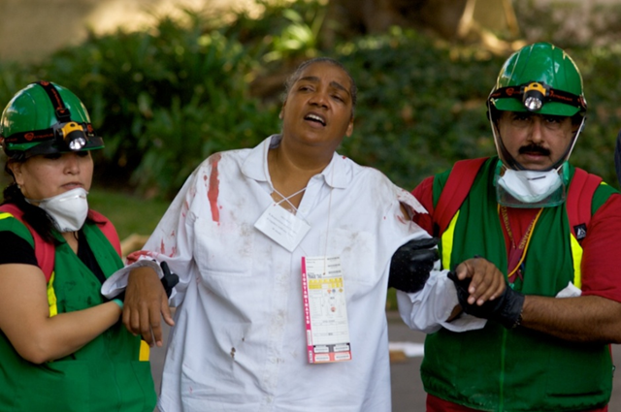
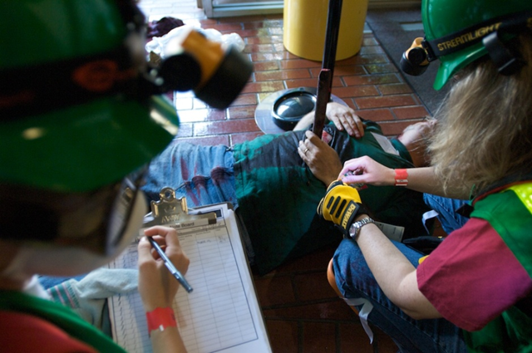
Triaging

Slide 13
Triage System
Make the scene safe to approach, Start where you stand!
“Anyone that can hear me, come to the sound of my voice!”
  Walking Wounded = MINOR
Systematic and Thorough
  Start with the first one you find
  Less than one minute per victim
Tag or mark
Document!
Repeat - Start with IMMEDIATES

Slide 14
Let’s Practice
Compound Fracture, Left femur
Respirations over 30/min
Radial pulse present
Awake
IMMEDIATE

Slide 15
Let’s Practice
Amputated left arm, bleeding controlled
Respirations under 30/min
Capillary refill under 2 seconds
Awake
IMMEDIATE

Slide 16
Let’s Practice
Impaled stick in arm
Respirations under 30/min
Capillary refill under 2 sec.
Awake
Walked to you
MINOR

Slide 17
Let’s Practice
Unable to move legs
Respirations under 30/min
Radial pulse present
Awake
DELAYED

Slide 18
Let’s Practice
90% Second Degree burns
Respirations none – repositioned twice
Radial pulse present
Unconscious
DECEASED

Slide 19
Head-to-Toe Assessment
Conducted on ALL victims
Verbal, hands-on
  Wear protective gear
Look, listen, and feel for anything unusual
  Assess from top to bottom
Assess completely before beginning treatment
Document: injuries and treatment
Treat all victims as if they have a spinal injury until certain they do not
Check color, warmth, and sensation on all extremities
Look for medical identification

Slide 20
DCAP-BTLS
Deformities
Contusions
Abrasions
Punctures
Burns
Tenderness
Lacerations
Swelling

Slide 21
Conducting Head-to-Toe Assessment
Pay careful attention
Look, listen, and feel
Suspect a spinal injury in unconscious survivors and treat accordingly
Check own hands for patient bleeding

Slide 22
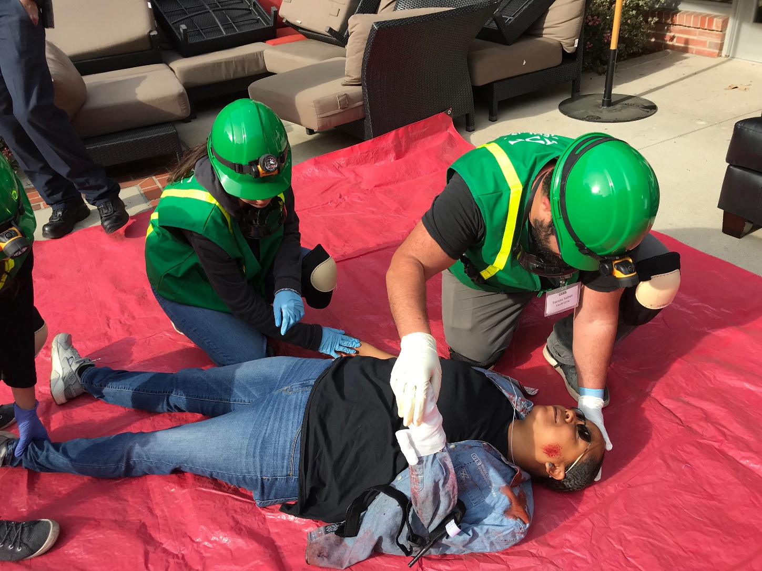
Order of Assessment
Head
Neck
Shoulders
Chest
Arms
Abdomen
Pelvis
Legs

Slide 23
Closed-Head, Neck, Spinal Injuries
If injuries to the head or spine are suspected, do no harm
  Minimize movement of head and neck while treating life-threatening conditions
If survivors exhibit signs or are found under heavy debris, treat them as having a closed-head, neck, or spinal injury

Slide 24
Public Health Considerations
Maintaining proper hygiene
Maintaining proper sanitation
Purifying water (if necessary)
Preventing spread of disease

Slide 25
Maintaining Hygiene
Wash hands frequently
  Or use alcohol-based hand sanitizer
Wear non-latex exam gloves
Keep dressings sterile
Wash areas that come in contact with body fluids

Slide 26
Maintain Sanitation
Control disposal of bacterial sources
Put waste products in plastic bags
  Tie off bags and mark them as medical waste
Bury human waste

Slide 27
Water Purification Methods
Boil water for 1 minute
Water purification tablets
Non-perfumed liquid bleach
  8 drops/gal of water
  16 drops/gal if water is cloudy
  Let stand for 30 minutes before use

Slide 28
Mass Casualty Incidents
Incidents in which the number of casualties overwhelms the local resources
  Commuter train derailment
  Multi-car accident
  Bus accident
  Building collapse
  Natural disasters (e.g., tornadoes)

Slide 29
Role of First Responder Personnel (1 of 2)
During mass casualty events, first responder personnel will:
  Establish command and control of the incident area
  Conduct a scene size-up and set-up
  Send survivors with relatively minor injuries to a holding area to await treatment
  Identify survivors who require life-saving interventions and treat them immediately

Slide 30
Role of First Responder Personnel (2 of 2)
During mass casualty events, first responder personnel will also:
  Identify deceased victims as well as survivors too severely injured to save
  Manage medical transportation for survivors who require additional treatment
  Secure the area to protect first responders, survivors, and evidence for law enforcement investigations
  Remove debris and other safety or health threats

Slide 31
Role of CERT Volunteers (1 of 2)
Respond to the Call Out notification
Check in and get assignment
Put on PPE and any CERT affiliated gear

Slide 32
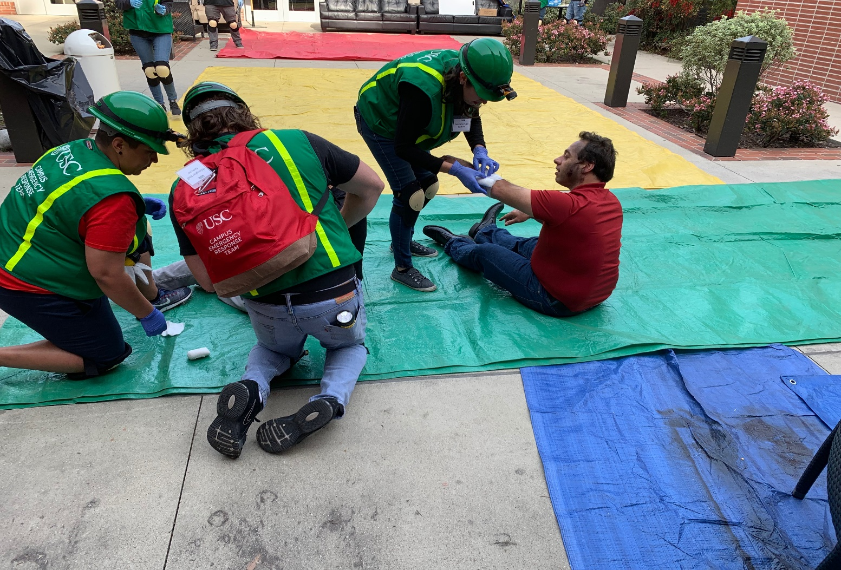
Functions of Disaster Medical Operations
Triage/Assessment
Treatment
Morgue

Slide 33
Establish a Medical Treatment Area
DPS will advise what location will be set up for the treatment area
  The EOC will decide the location
  There is a predetermined list from which the EOC will pick from

Slide 34
Safety for Rescuers
  YOUR safety is the number one priority

