Slide 1

Disaster Medical Operations - Part 1
USC CERT Basic Training

Slide 2
Unit 3 Objectives
Identify life-threatening conditions resulting from trauma including severe bleeding, low body temperature, and airway blockage
Apply correct life saving techniques
Provide basic first-aid care for non-life threatening injuries
Learn the basics of Triage

Slide 3
Treating Life-Threatening Conditions
The “killers”: Airway Obstruction, Excessive Bleeding, and Shock.
Without treatment, severe bleeding and airway obstruction can quickly lead to death
The first priority of CERT volunteers assisting in disaster medical operations is to attend to these conditions by:
  Open the airway
  Controlling bleeding
  Treat for shock

Slide 4
Safety Considerations
Prior to treatment, ensure that both the patient and rescuer are in a safe environment to administer care
Some questions CERT volunteers to consider
  Do I feel safe at this spot?
  Should I leave and move to a safer location, or am I able to stay and start providing care immediately?
  If I leave, can I take anyone with me?
  Do I have what I need to treat the patient?

Slide 5
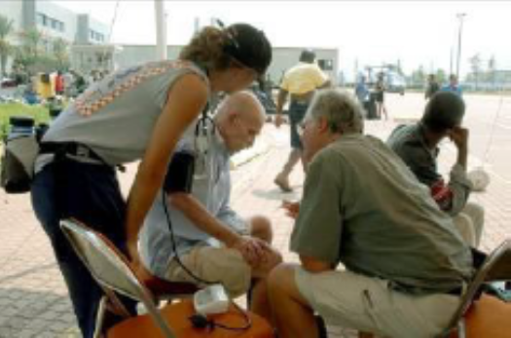
Approaching the Patient
Be sure patient can see you
Identify yourself
  Your name and name of your organization
Request permission to treat, if possible
Respect cultural differences
Protect patient privacy

Slide 6
START
START = Simple Triage and Rapid Treatment
  Victims sorted based on priority of treatment
  Rapid treatment of injuries assessed
  GREATEST good for GREATEST number

Slide 7
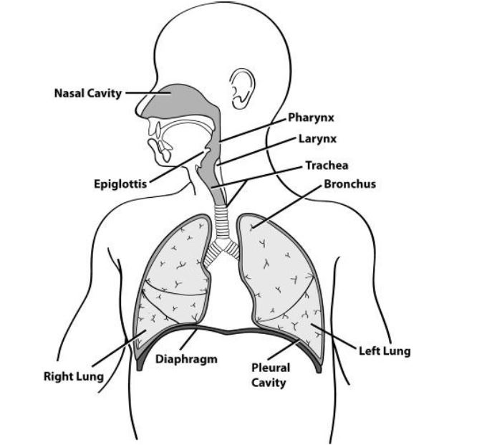
Opening the Airway

Slide 8
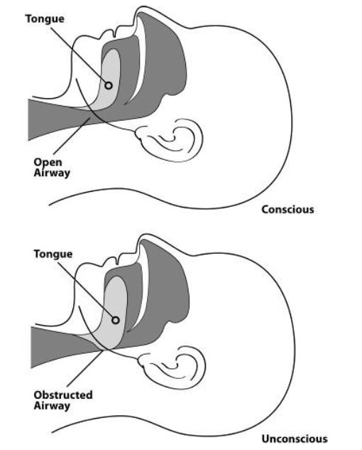
Open vs. Obstructed Airway

Slide 9
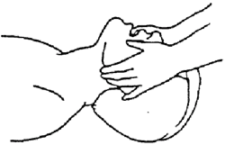
Jaw-thrust Maneuver
Kneel above the patient’s head
Put one hand on each side of the patient’s head with the thumbs near the corners of the mouth pointed toward the chin, using the elbows for support
Slide the fingers into position under the angles of the patient’s jawbone without moving the head or neck
Thrust the jaw upward without moving the head or neck to lift the jaw and open the airway

Slide 10
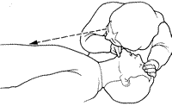
Look, Listen, and Feel
Look – For chest rise and fall
Listen – For air exchange
Feel – for air exchange on your cheek

Slide 11
Triage – Are they breathing?

Slide 12
Recovery Position
Body: Laid on its side
Bottom Arm: Reached outward
Top Arm: Rest hand on bicep of bottom arm
Head: Rest on hand
Legs: Bent slightly
Chin: Raised forward
Mouth: Pointed downward

Slide 13
Life-Threatening Bleeding
Indicators of life-threatening bleeding:
  Spurting/steady bleeding
  Blood is pooling
  Blood is soaking through over lying clothes
  Blood is soaking through bandages
  Amputation

Slide 14
Stages of Severe Bleeding
Stage | Blood Loss | Heart Rate | Blood Pressure | Breath Rate | Patient
I | Less than 15% | Normal (<100 bpm) | Normal | 14-20 | Patient appears normal
II | 15%-40% | Fast (>100 bpm) | Slightly Low | 20-30 | Patient may feel anxious
III | 30%-40% | Very Fast (>120 bpm) | Low | 30-40 | Patient feels confused
IV | Greater than 40% | Critical (>140 bpm) | Critical | >35 | Patient feels lethargic

Slide 15
Types of Bleeding
Arterial bleeding: Arteries transport blood under high pressure
  Blood coming from an artery will spurt
Venous bleeding: Veins transport blood under low pressure
  Blood coming from a vein will flow
Capillary bleeding: Capillaries also carry blood under low pressure
  Blood coming from capillaries will ooze

Slide 16
Types of Bleeding (image)

Slide 17
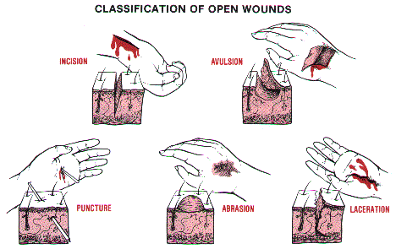
Wound Classificationimage)

Slide 18
Controlling Bleeding: Direct Pressure
Step 1: Find the source(s)
Step 2: Cover the source – gauze and wrap
Step 3: Apply pressure – direct pressure
Step 4: Maintain pressure until bleeding
has stopped and elevate
Step 5: Pressure point – arm, groin, and leg

Slide 19
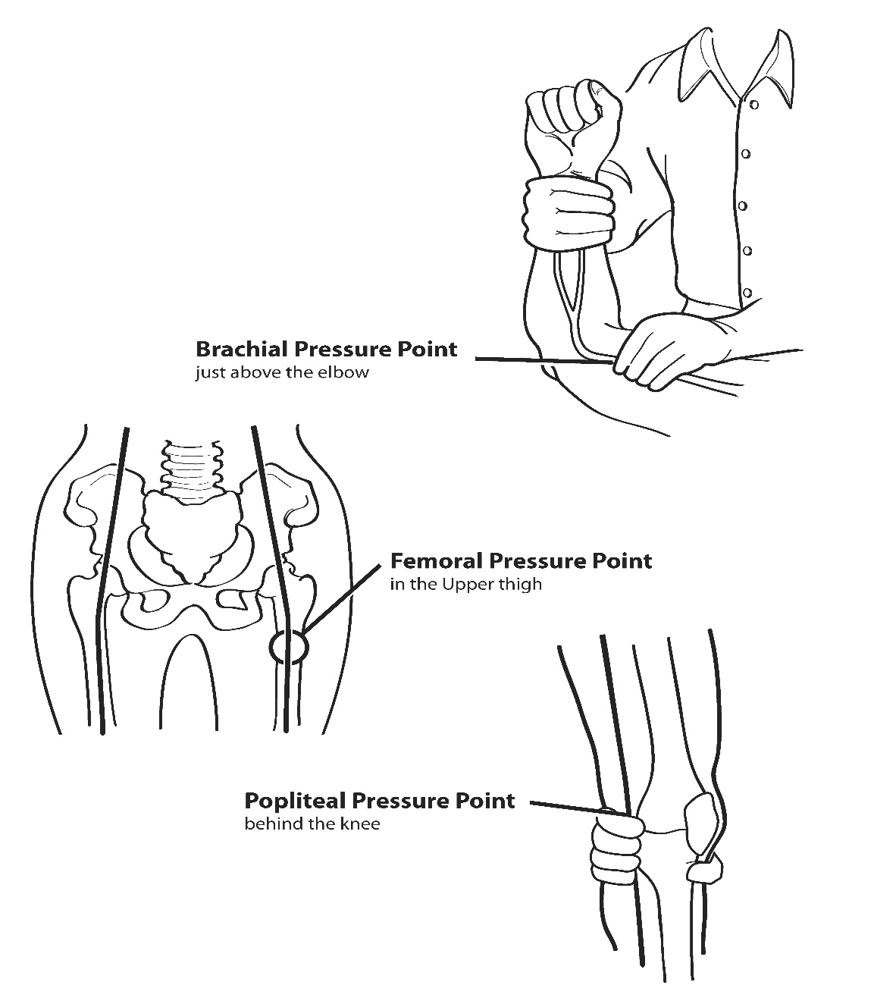
Pressure Points

Slide 20
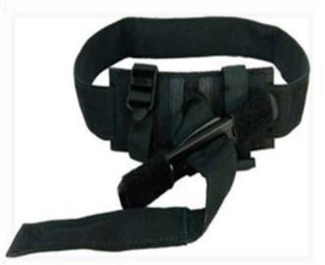
Controlling Bleeding: Tourniquets
Use direct pressure, elevation and pressure points to stop bleeding first
If bleeding can’t be stopped and getting professional treatment is delayed a tourniquet may be a viable option to save a person from bleeding to death
Ideally use a medical grade tourniquet. Do not use materials like rope, wire, or string that can cut into the patient’s flesh

Slide 21
Controlling Bleeding: Tourniquets
Place the tourniquet between the wound and the heart (for example, if the wound is on the wrist, you would tie the tourniquet around the forearm).
Tie the piece of material around the limb.
Place a stick, pen, ruler, or other sturdy item against the material and tie a knot around the item, so that the item is knotted against the limb.
Use the stick or other item as a lever to twist the knot more tightly against the limb, tightening the bandage until the bleeding stops

Slide 22
Controlling Bleeding: Tourniquets
5. Tie one or both ends of the lever against the limb to secure it and
maintain pressure.
6. Mark the patient in an obvious way that indicates that a tourniquet
was used and include the time it was applied.
7. Do not loosen a tourniquet once it has been applied.
8. Only proper medical authorities should remove a tourniquet.
9. Monitor patient for symptoms of shock.

Slide 23
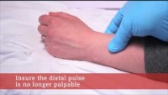
Tourniquet Video
YouTube video:
https://www.youtube.com/watch?v=VJFGZC8UvP8

Slide 24
Wound Care
In the absence of active bleeding, remove dressing and flush, check wound at least every 4-6 hours
If there is active bleeding, redress over existing dressing and maintain pressure and elevation

Slide 25
Rules of Dressing
If active bleeding:
  Redress OVER existing dressing
If no active bleeding:
  Maintain the pressure and keep wound bandaged until further treatment by a medical professional

Slide 26
Signs of Infection
Signs of possible infection:
  Swelling around wound site
  Discoloration
  Discharge from wound
  Red striations from wound site

Slide 27
Impaled Objects
When foreign object is impaled in patient’s body:
  Immobilize affected body part
  Do not attempt to move or remove
  Try to control bleeding at entrance wound
  Clean and dress wound, making sure to stabilize impaled object

Slide 28
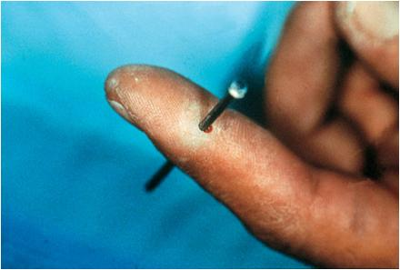
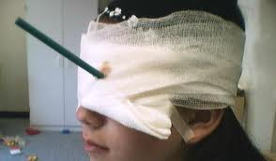
Treating impaled Objects
Immobilize affected body part
Don’t move or remove
Control bleeding at entrance wound
Clean and dress wound making sure impaled object is stabilized

Slide 29
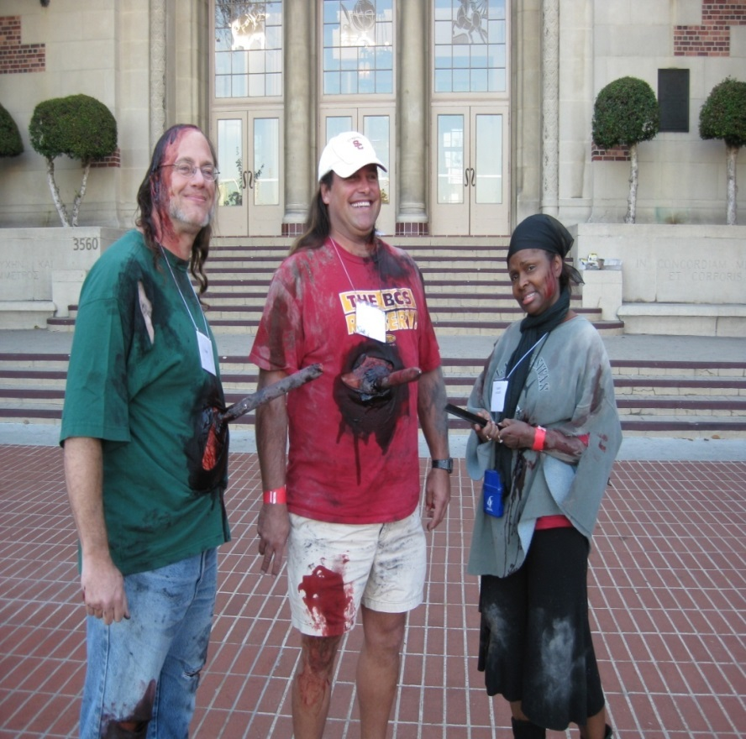
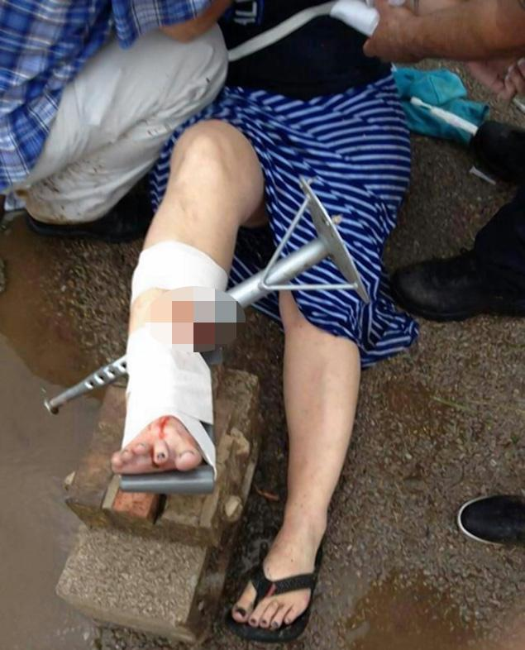
Impaled Objects
USC Drill Oklahoma Tornado - Teacher

Slide 30
Nasal Bleeding
Causes:
  Blunt force
  Skull fracture
  Non-trauma-related conditions – sinus infection, high blood pressure, and bleeding disorders
Blood loss can lead to shock – may not know how much blood has been lost because victim will swallow some
Victims may become nauseated and vomit if they swallow blood.

Slide 31
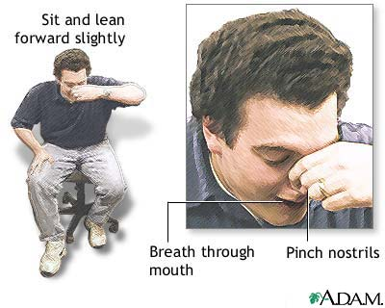
Treatment of Nasal Bleeding
Control nasal bleeding:
  Pinch nostrils or put pressure on upper lip under nose
  Have victim sit with head forward, NOT back
Ensure that airway remains open
Keep victim calm

Slide 32
Amputations
Control bleeding
Clean wound
Treat for shock
Save tissue parts, wrapped in clean cloth and place in a plastic bag
Keep tissue cool, but NOT directly on ice
Keep severed part with the victim
Tag Immediate during Triage!

Slide 33
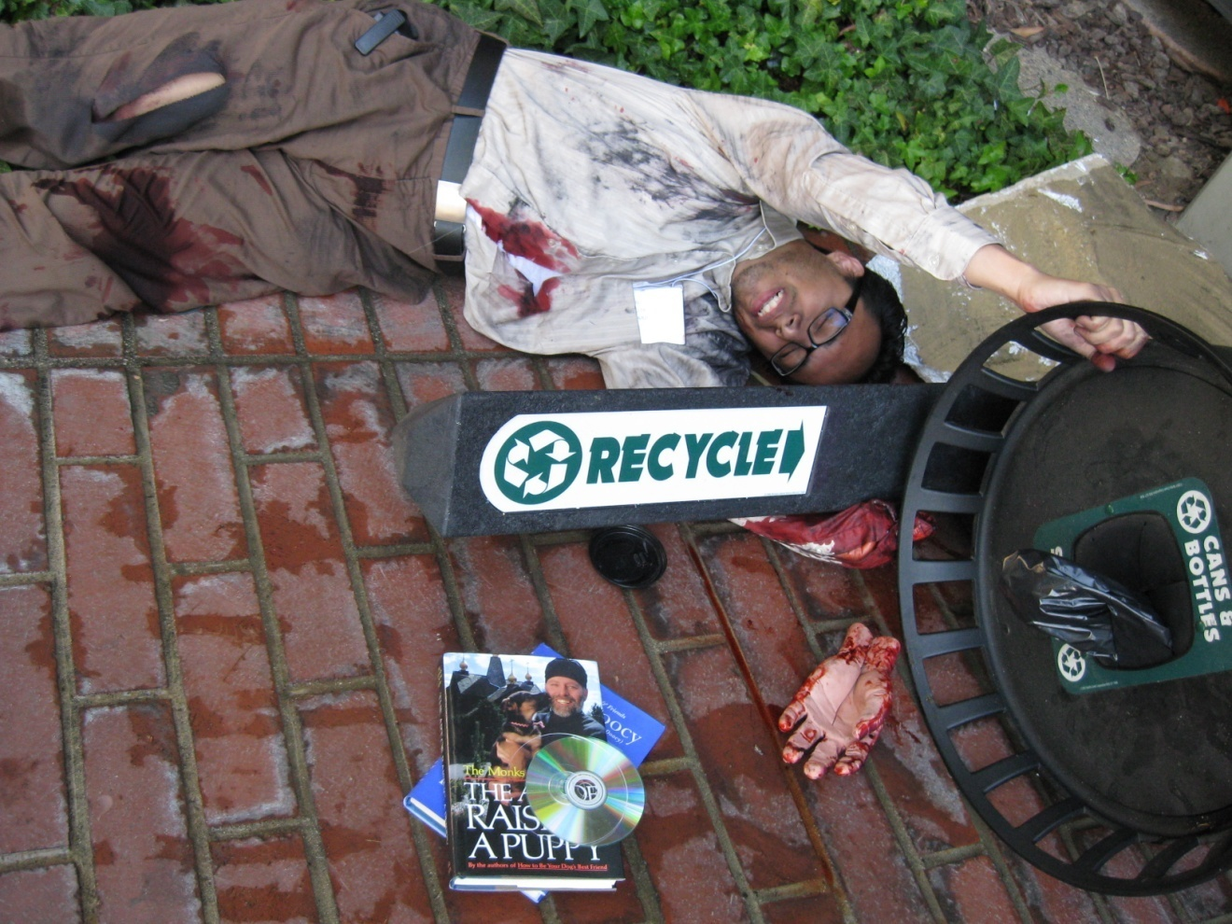
Treating Amputations

Slide 34
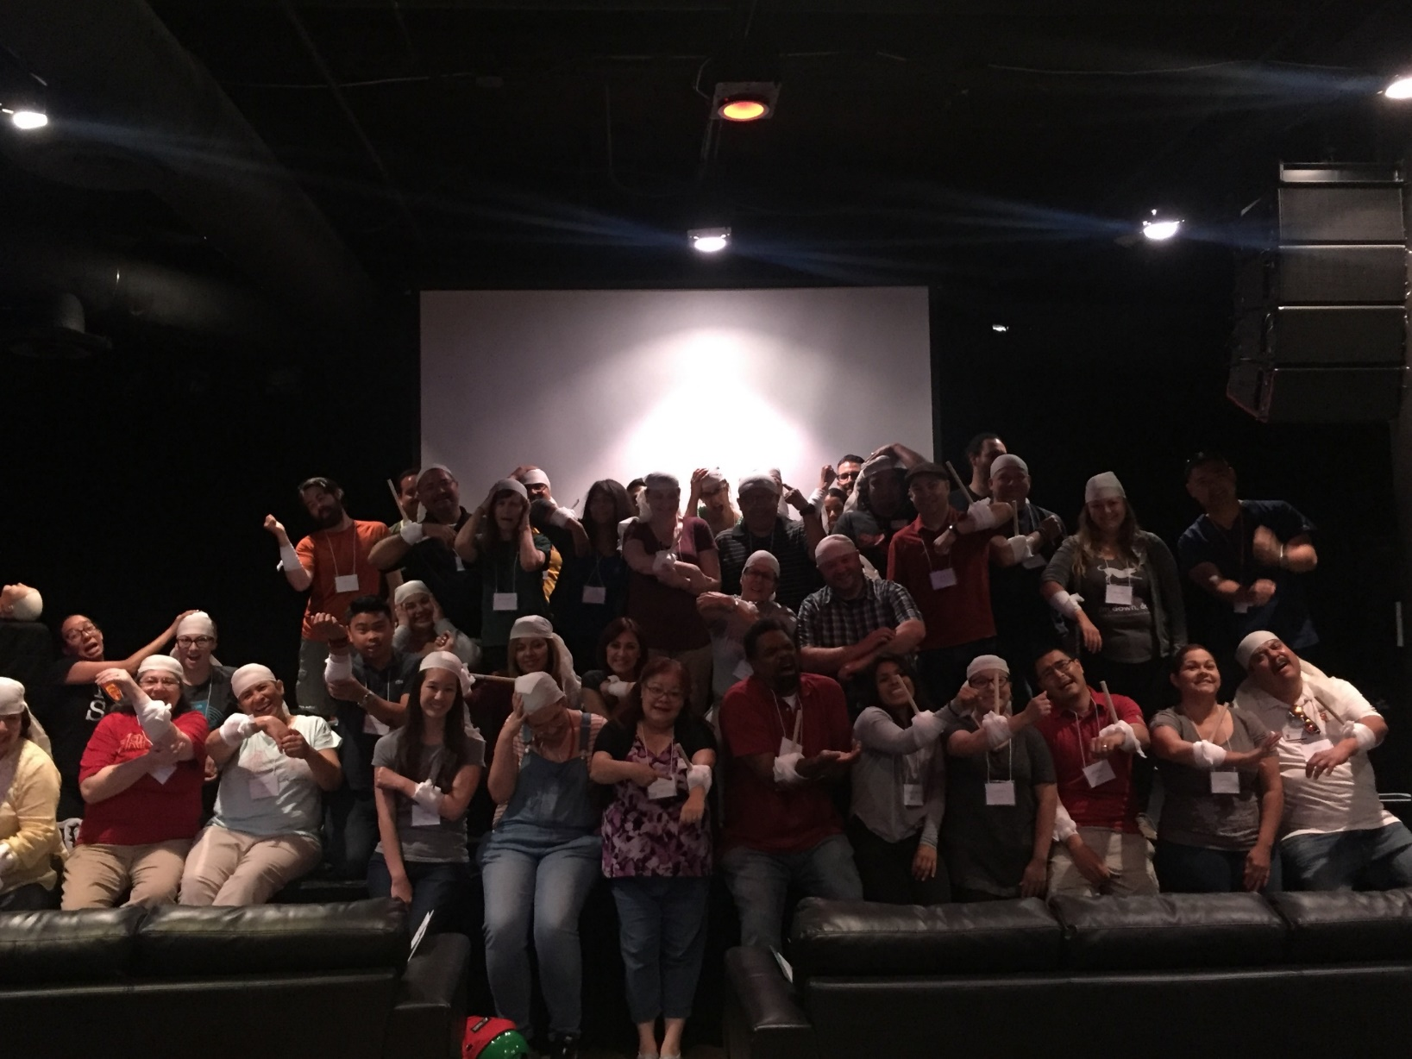
CERT Practice

Slide 35
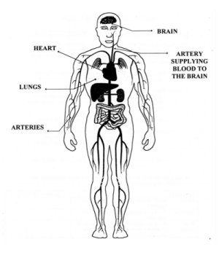
Shock
Result of ineffective circulation of the blood
Primary cause in a disaster: blood loss
Remaining in shock will result in Cell, Tissue and Organ death
Important to continually re-evaluate and monitor victims for symptoms of shock

Slide 36
Shock
Shock is often difficult to diagnose
Main signs of shock:
  Rapid and shallow breathing
  Capillary refill of greater than two seconds
  Failure to follow simple commands, such as “squeeze my hand
Symptoms of shock are easily missed. Pay careful attention to your patient

Slide 37
Recognizing Shock
Rapid Breathing
  >30 breaths per minute (very shallow)
Inadequate circulation
  Capillary blanch >2 seconds
Mental Status
  Unconscious, or
  Unable to follow simple command, “squeeze my hand”
  Symptoms of shock are easily missed… pay careful attention to your patient!

Slide 38
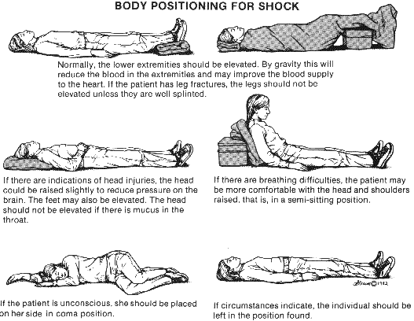
Treating Shock
Lay victim on back
  Maintain open airway
Elevate feet
Control bleeding
Maintain body temperature

Slide 39
Triage

Slide 40
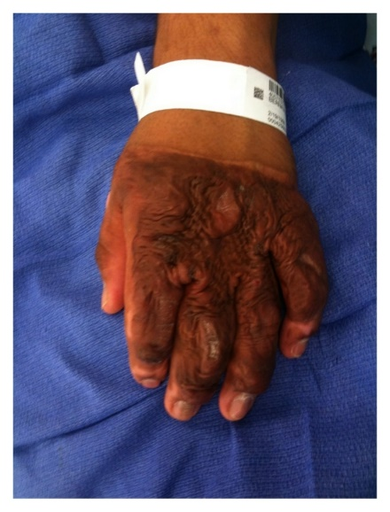
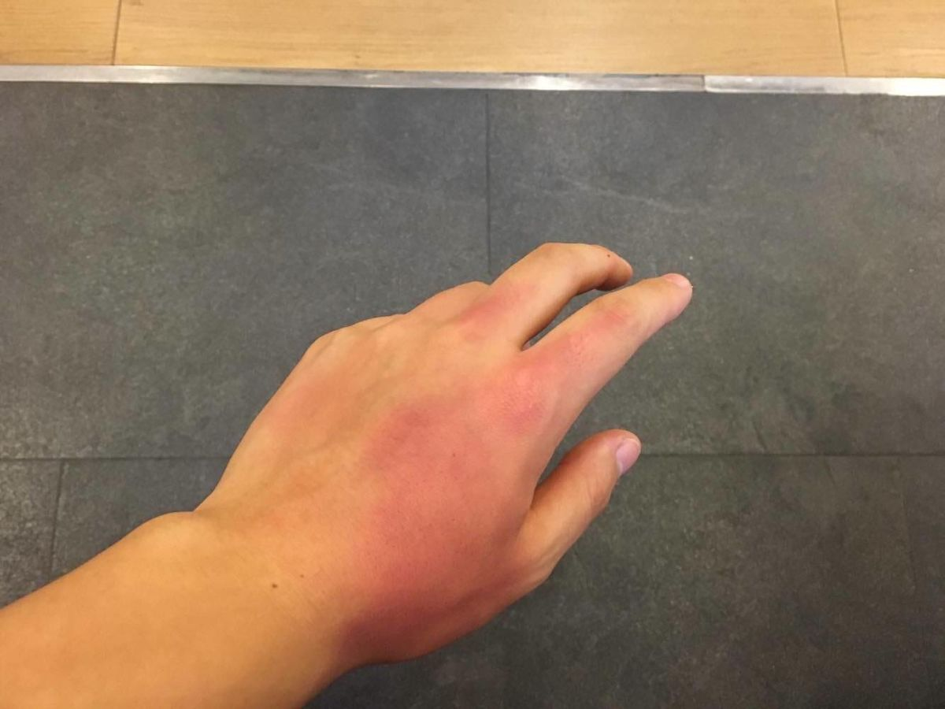
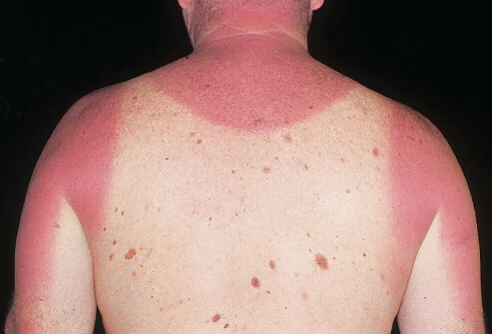


Burns
Causes
  Heat
  Radiation
  Chemical
  Electrical current
Sun Burn

Slide 41
Burn Severity
Factors that affect burn severity:
  Temperature of burning agent
  Period of time survivor exposed
  Area of body affected
  Size of area burned
  Depth of burn

Slide 42
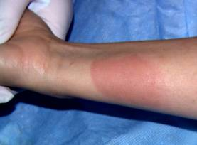
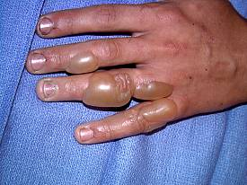
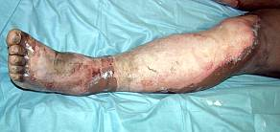
Burn Classifications
Classification | Skin Layers Affected | Signs
1st Degree | Epidermis (superficial) | Reddened, dry skin Pain Swelling (possible)
2nd Degree | Epidermis Partial destruction of dermis | Reddened, blistered skin Wet appearance Pain Swelling (possible)
3rd Degree (Full Thickness Burns) | Complete destruction of epidermis and dermis Possible subcutaneous damage (destroys all layers of skin and some or all underlying structures) | Whitened, leathery, or charred (brown or black) Painful or relatively painless
1st Degree
2nd Degree
3rd Degree

Slide 43
Treatment for Chemical Burns
Remove cause of burn and affected clothing or jewelry
If irritant is dry, gently brush away as much as possible
  Always brush away from eyes, survivor, and yourself
Flush with lots of cool running water
Apply cool, wet compress to relieve pain
Cover wound loosely with dry, sterile or clean dressing

Slide 44
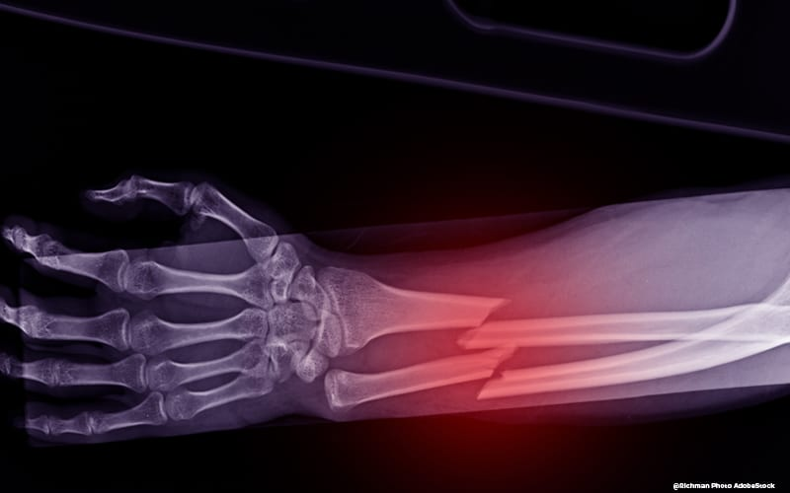
Fractures, Dislocations, Sprains, Strains
Immobilize injury and joints immediately above and below injury site
If uncertain of injury type, treat as fracture

Slide 45
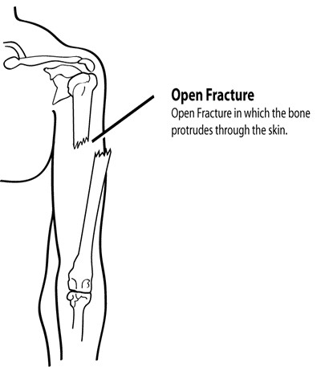
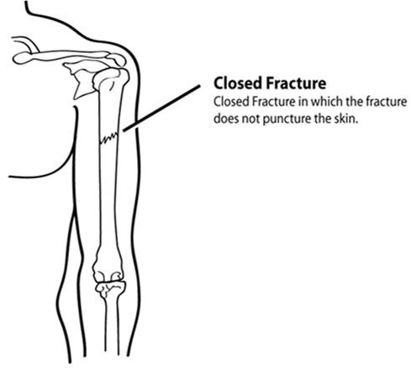
Types of Fractures (1 of 2)

Slide 46
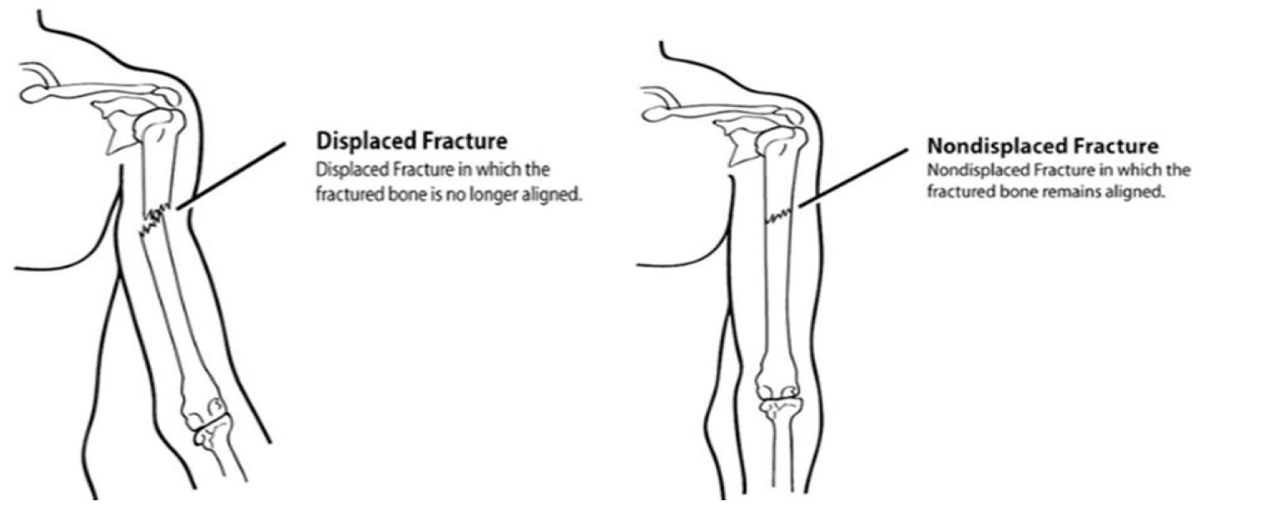
Types of Fractures (2 of 2)

Slide 47
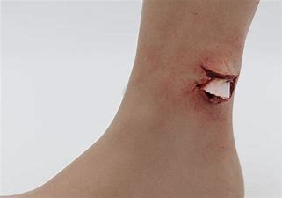
Treating Open Fractures
Do not draw exposed bone ends back into tissue
Do not irrigate wound
Cover wound with sterile dressing
Splint fracture without disturbing wound
Place moist dressing over bone end

Slide 48
Dislocations
Dislocation is injury to ligaments around a joint
  It is so severe that it permits separation of bone from its normal position in a joint
Treatment:
  Immobilize; do NOT relocate
  Check Pulse, Movement, and Sensation (PMS) before and after splinting/immobilization

Slide 49
Signs of Sprain
Tenderness at site
Swelling and bruising
Restricted use or loss of use

Slide 50
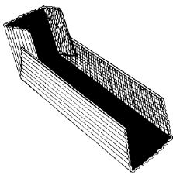
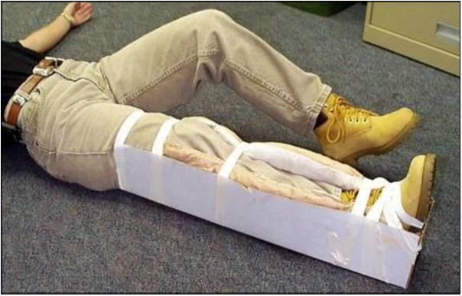
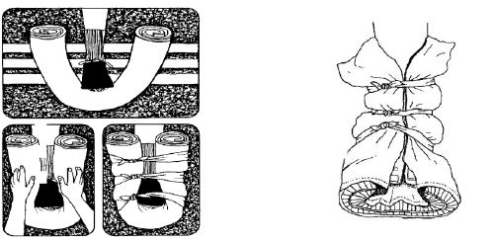
Splinting

Slide 51
Providing Comfort
What can you do?
  Keep them warm
  Offer a hand to hold
  Maintain eye contact
  Be patient and understanding
  If you have to move on to provide aid to another person, let them know

